Slide 1
Solar Resource Data and
Digital Tools for Renewable
Energy Scale-Up
Scaling Up Renewable Energy in Europe and Central Asia
May 26-28, 2026, Vienna, Austria, World Bank Group
Marcel Suri
CEO, Solargis

Slide 2
Table of contents
Solar data and tools used in solar energy
1. Building inventory and finding the best locations
2. Supporting large-scale PV development sites
3. Managing large fleets of solar

Slide 3
Solar data and tools used in solar energy

Slide 4
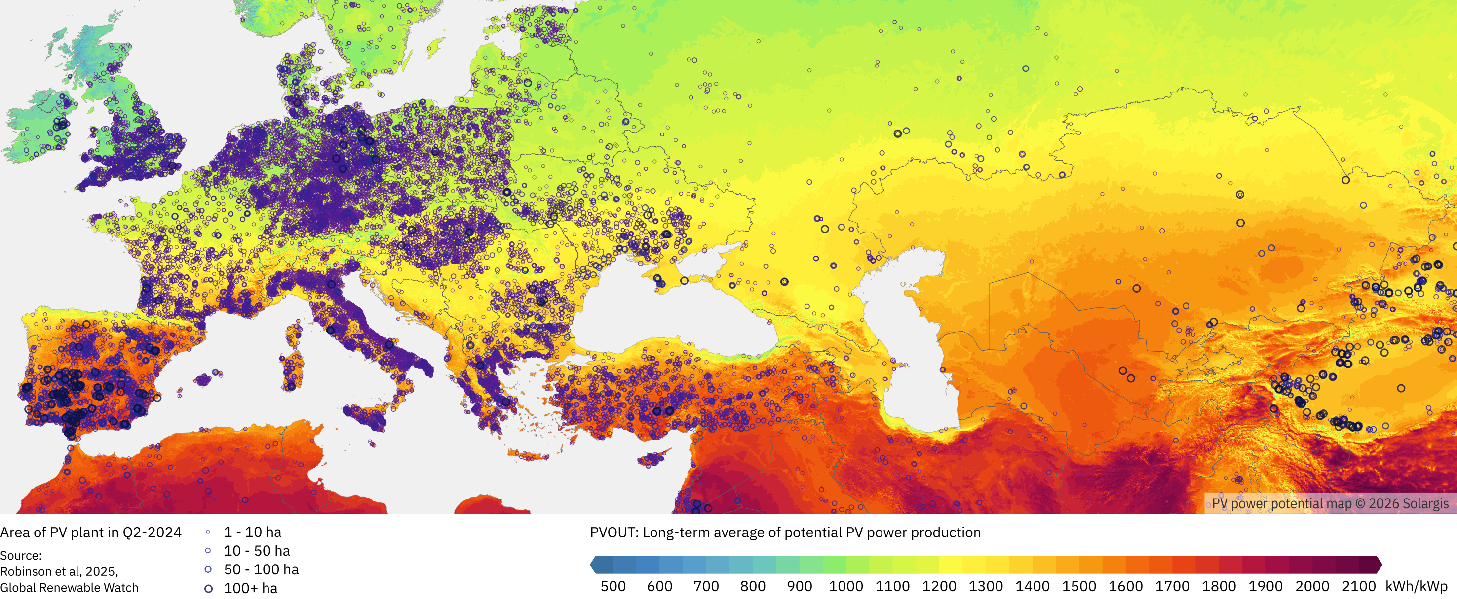
Solar PV in the region today

Slide 5
Solar PV in the region today

Slide 6
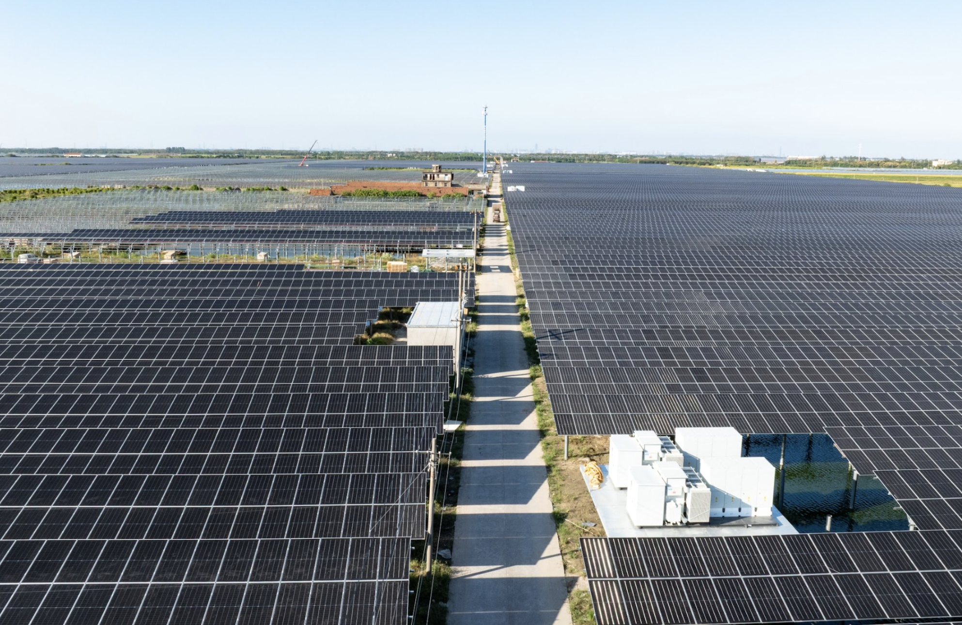
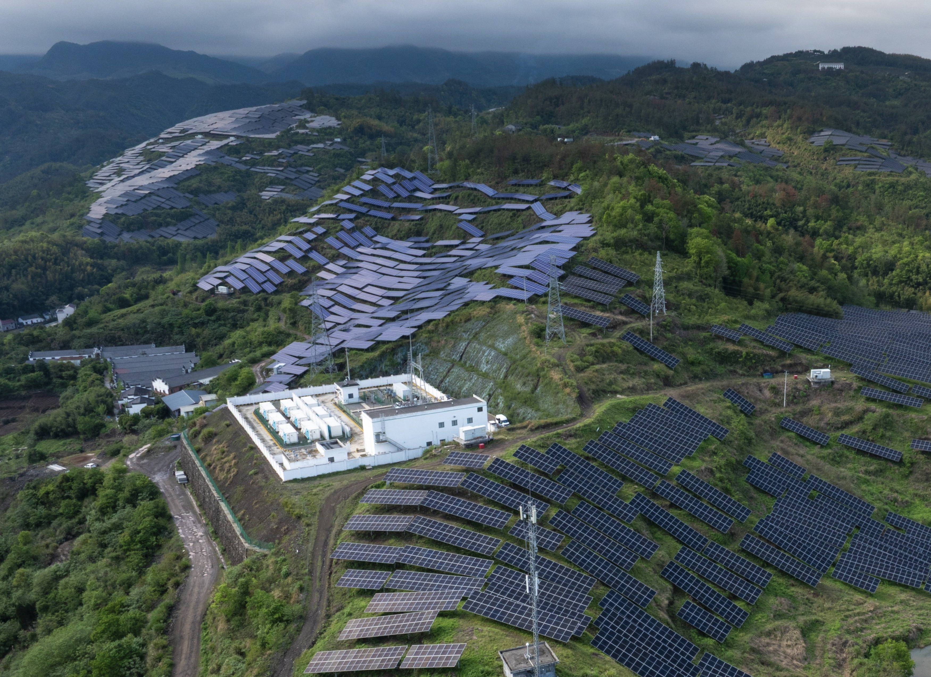
Variable renewable energy generation
Typical utility-scale project: Hybrid PV + storage
Development and operation of solar projects strongly depends on meteorological data
Data
Solar resource: primary data for development and management
Meteorological: temperature, wind, snow, pollution affect performance
Software tools
Development: energy design, simulation, grid and revenue modelling
Operation: performance evaluation, solar power forecast
Source: Adobe stock

Slide 7
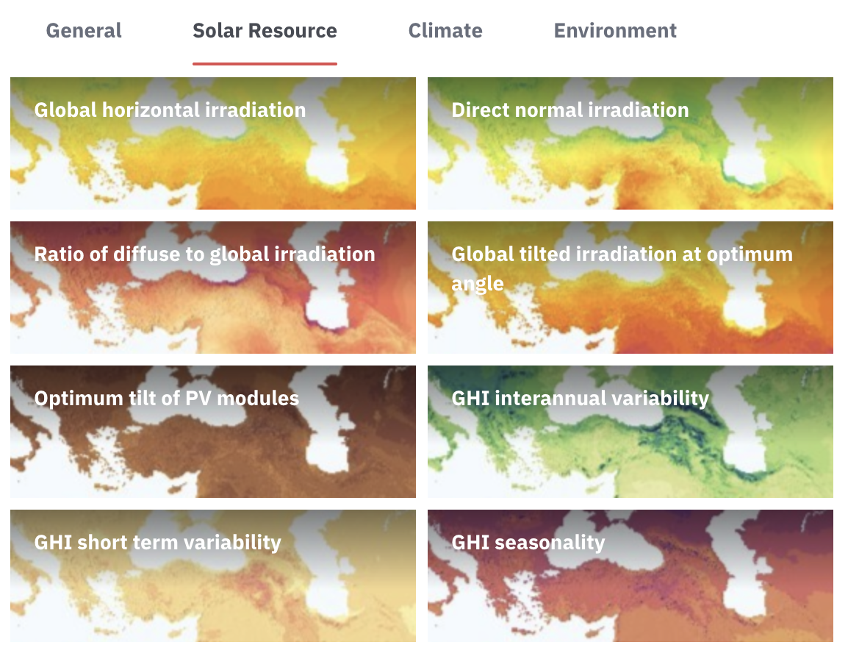
Variable renewable energy generation
Typical utility-scale project: Hybrid PV + storage
Development and operation of solar projects strongly depends on meteorological data
Data
Solar resource: primary data for development and grid management
Meteorological: temperature, wind, snow, pollution affect performance
Software tools
Development: energy design, simulation, grid and revenue modelling
Operation: performance evaluation, solar power forecast

Slide 8
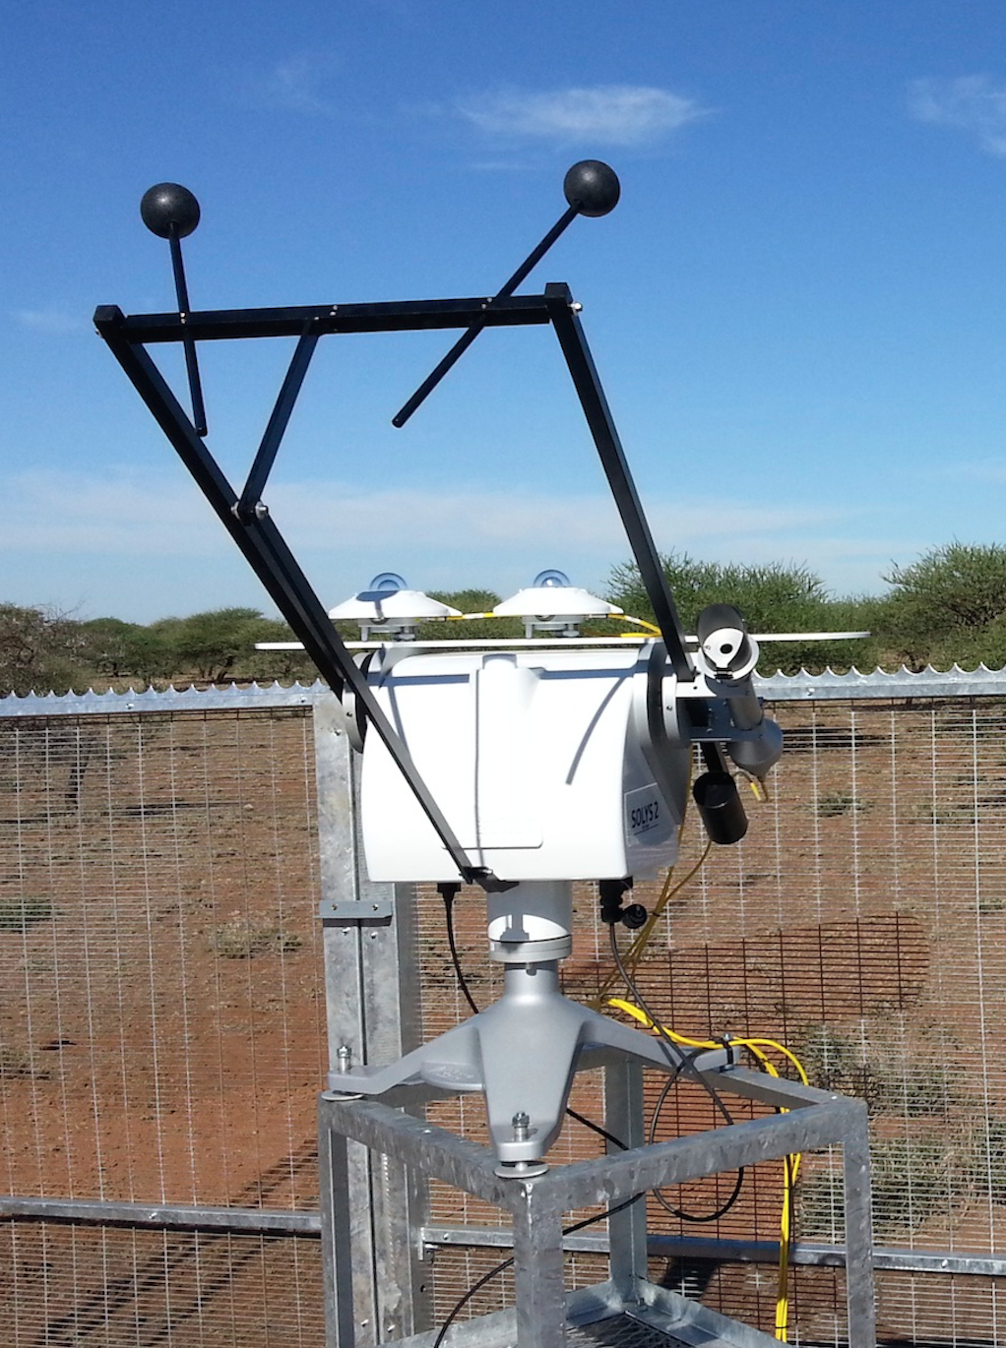
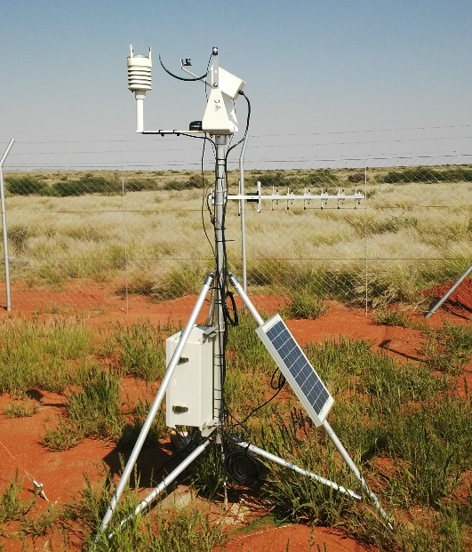

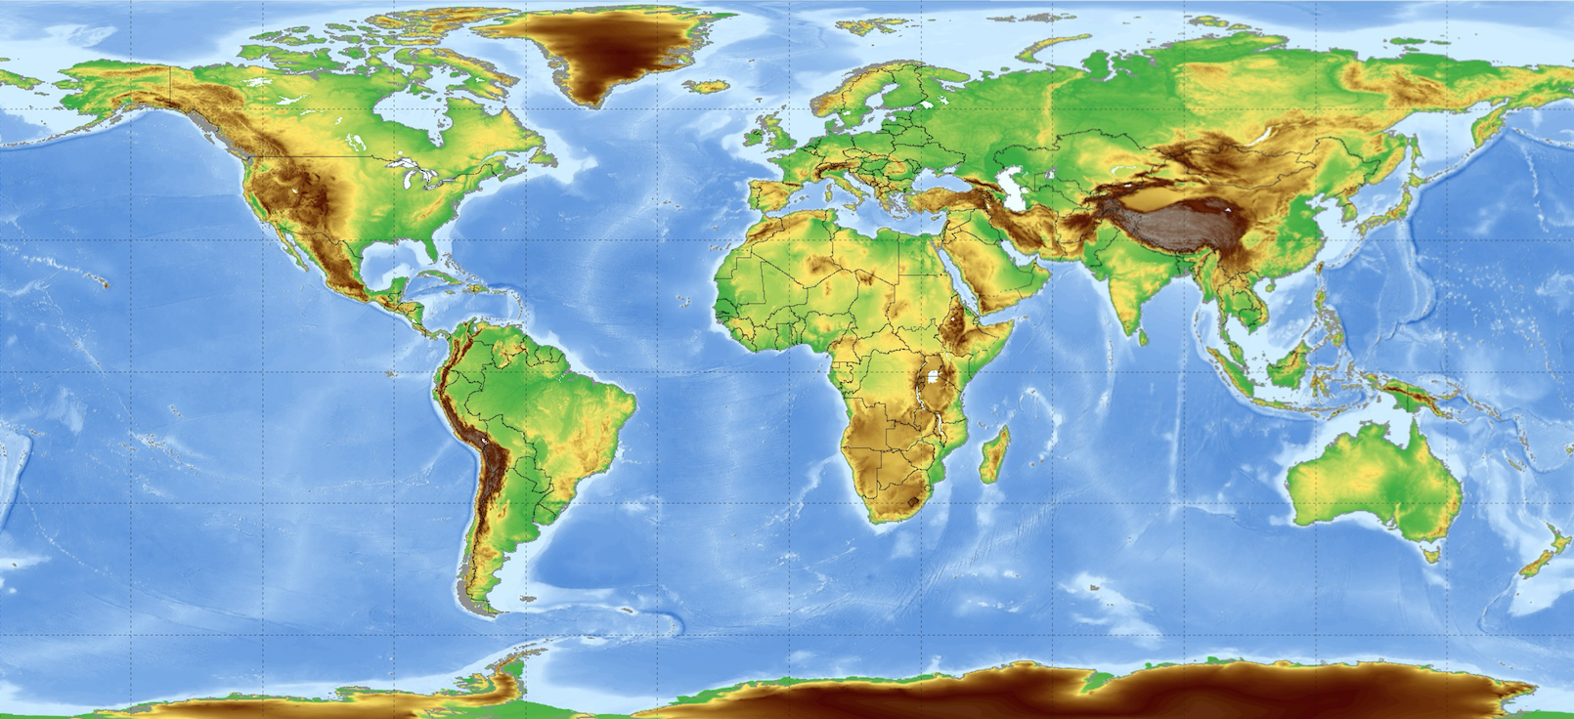
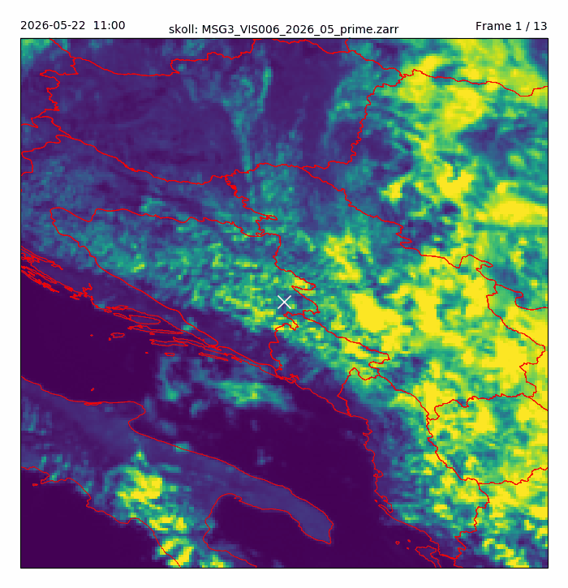
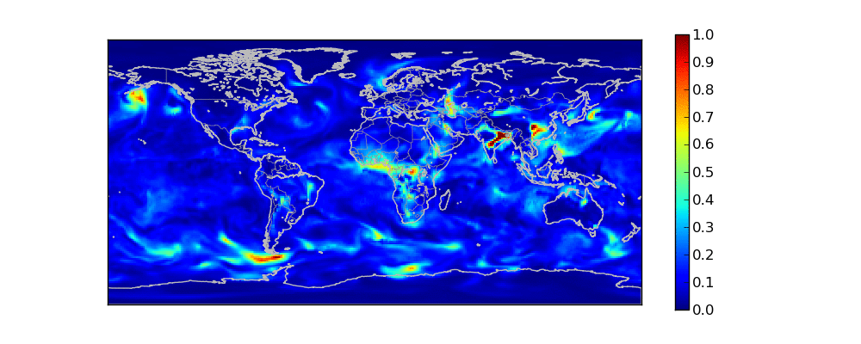
How solar database is developed
Data for solar projects needs to be available for any location in the same quality
Therefore, it is computed by models using three data inputs:
Geostationary satellite data
Global meteorological models
Meteorological ground measurements

Slide 9
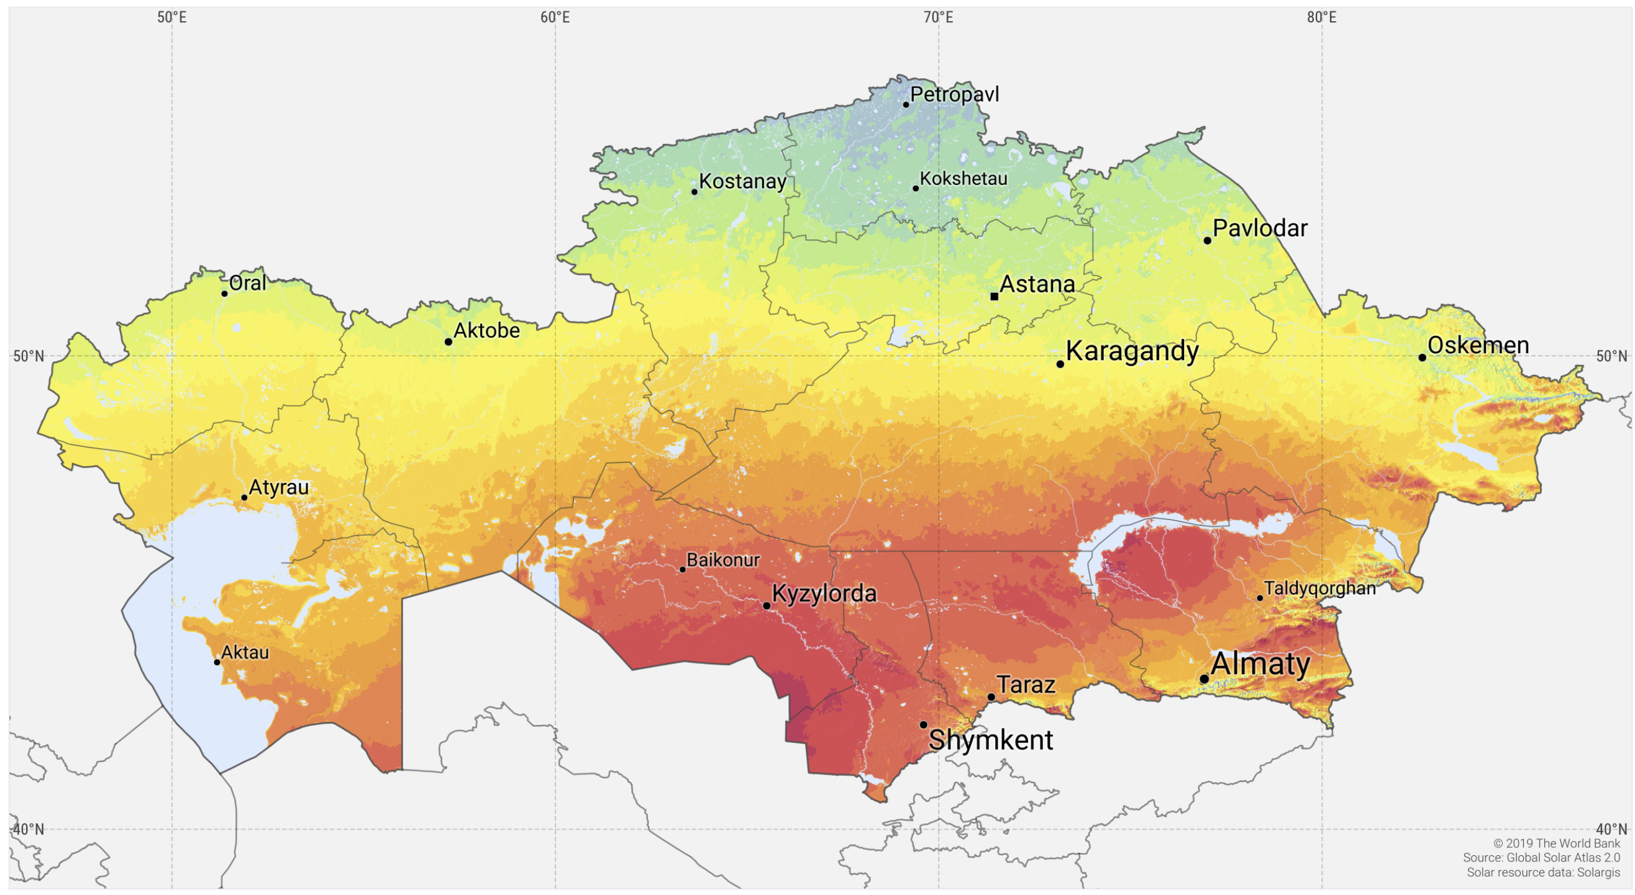
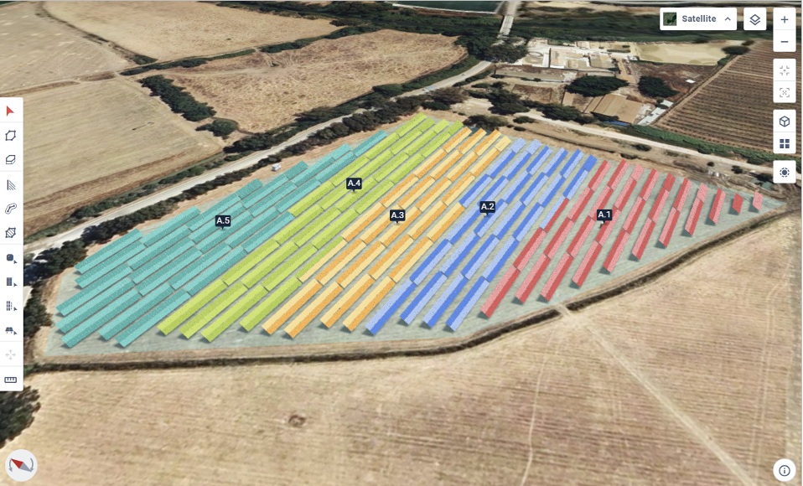
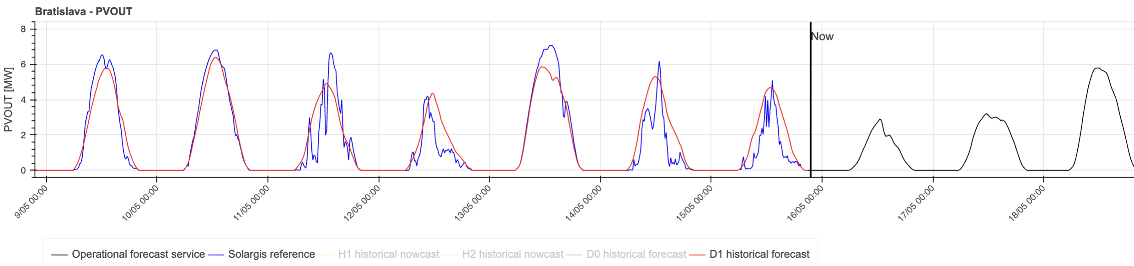
Use of solar and meteo data across project lifecycle
Inventory of the country’s solar potential and risks
Aggregated historical data and maps to find the best locations
Project development: Optimization of technical design and a financial plan
Detailed and accurate historical time series data (30+ years)
Monitoring of technical and financial performance of projects
Data for recent history (last months)
Solar power forecast to integrate large fleet of PV into electricity grids
Solar forecast data (up to next 14 days)

Slide 10
Use of solar and meteo data across project lifecycle
Inventory of the country’s solar potential and risks
Aggregated historical data and maps to find the best locations
Project development: Optimization of technical design and a financial plan
Detailed and accurate historical time series data (30+ years)
Monitoring of technical and financial performance of projects
Data for recent history (last months)
Solar power forecast to integrate large fleet of PV into electricity grids
Solar forecast data (up to next 14 days)

Slide 11
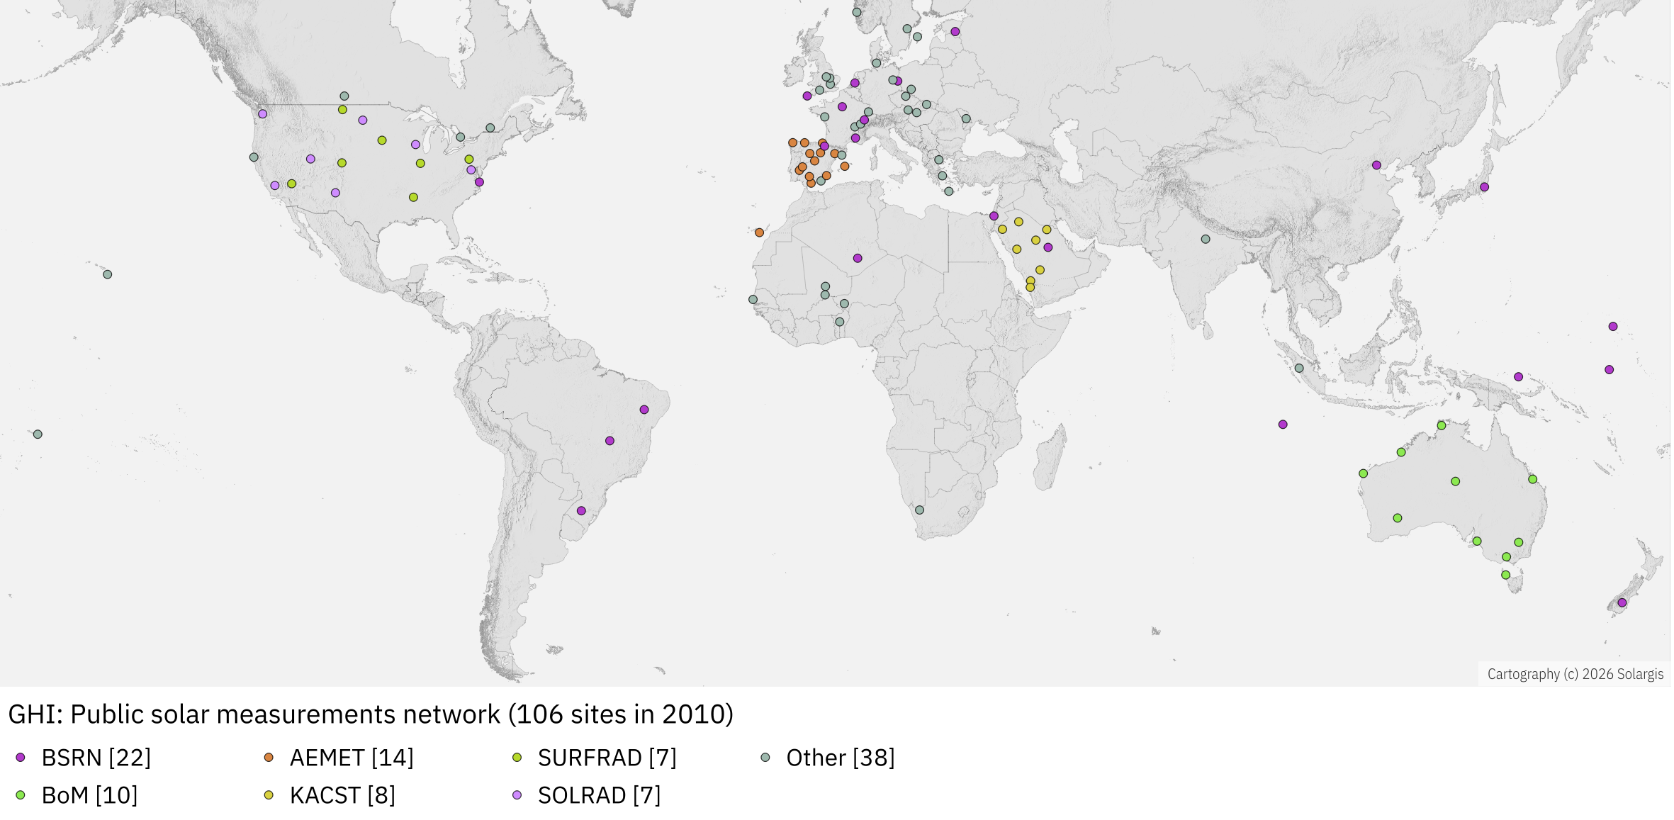
Solar models: Reduced uncertainty by ground measurements
To make solar data accurate, to attract investment, the models need to be calibrated by ground measurements
Year 2010: Limited number of good measurements across the world (approx. 106 sites)

Slide 12
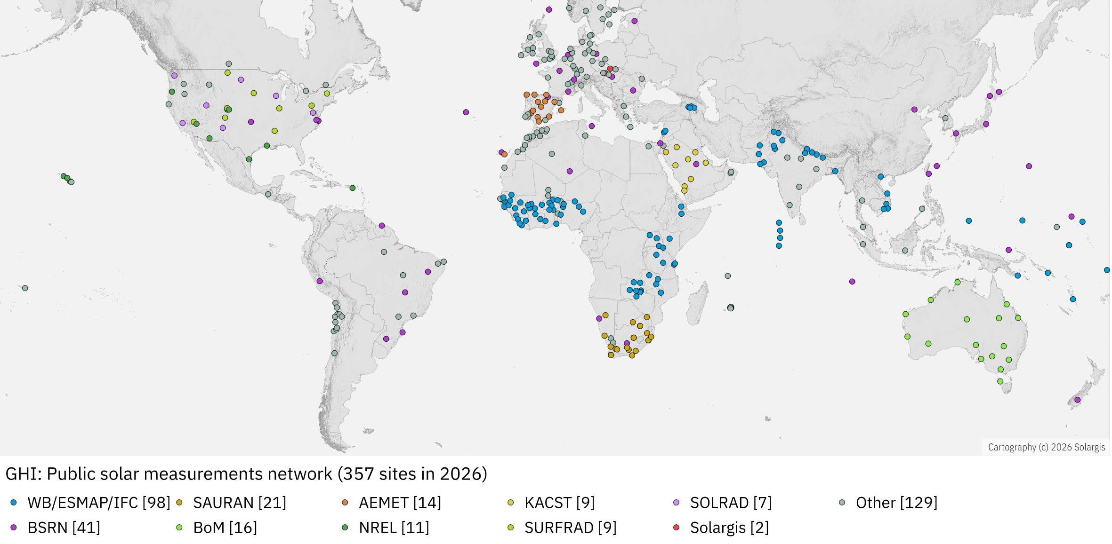
Solar models: Reduced uncertainty by ground measurements
To make solar data accurate, to attract investment, the models need to be calibrated by ground measurements
Year 2026: Measurement campaigns in South Africa, India, Chile, Morocco, Saudi Arabia
World Bank initiatives in Pakistan, Nepal, Vietnam, West/East Africa, Pacific
Ground measurement
campaign in West Africa:
Yearly GHI model uncertainty
reduced from 6-9% to 4-5%

Slide 13
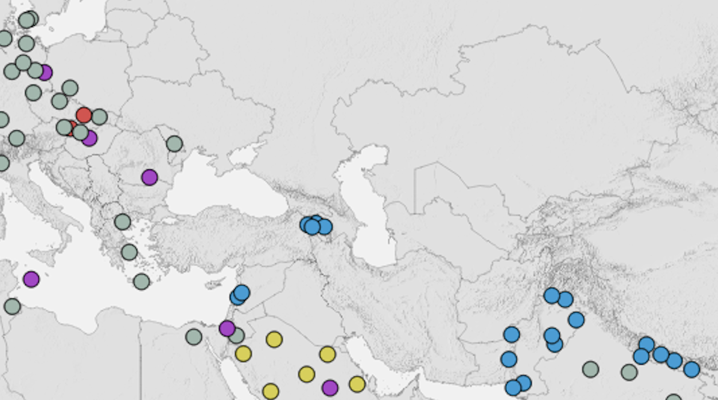
Missing solar measurements
To make solar data accurate, to attract investment, the models need to be calibrated by ground measurements
Year 2026: Public solar measurements in Balkan, Caucasus, Turkey and Central Asia missing

Slide 14
Topic 1
Building inventory and finding best locations for solar

Slide 15
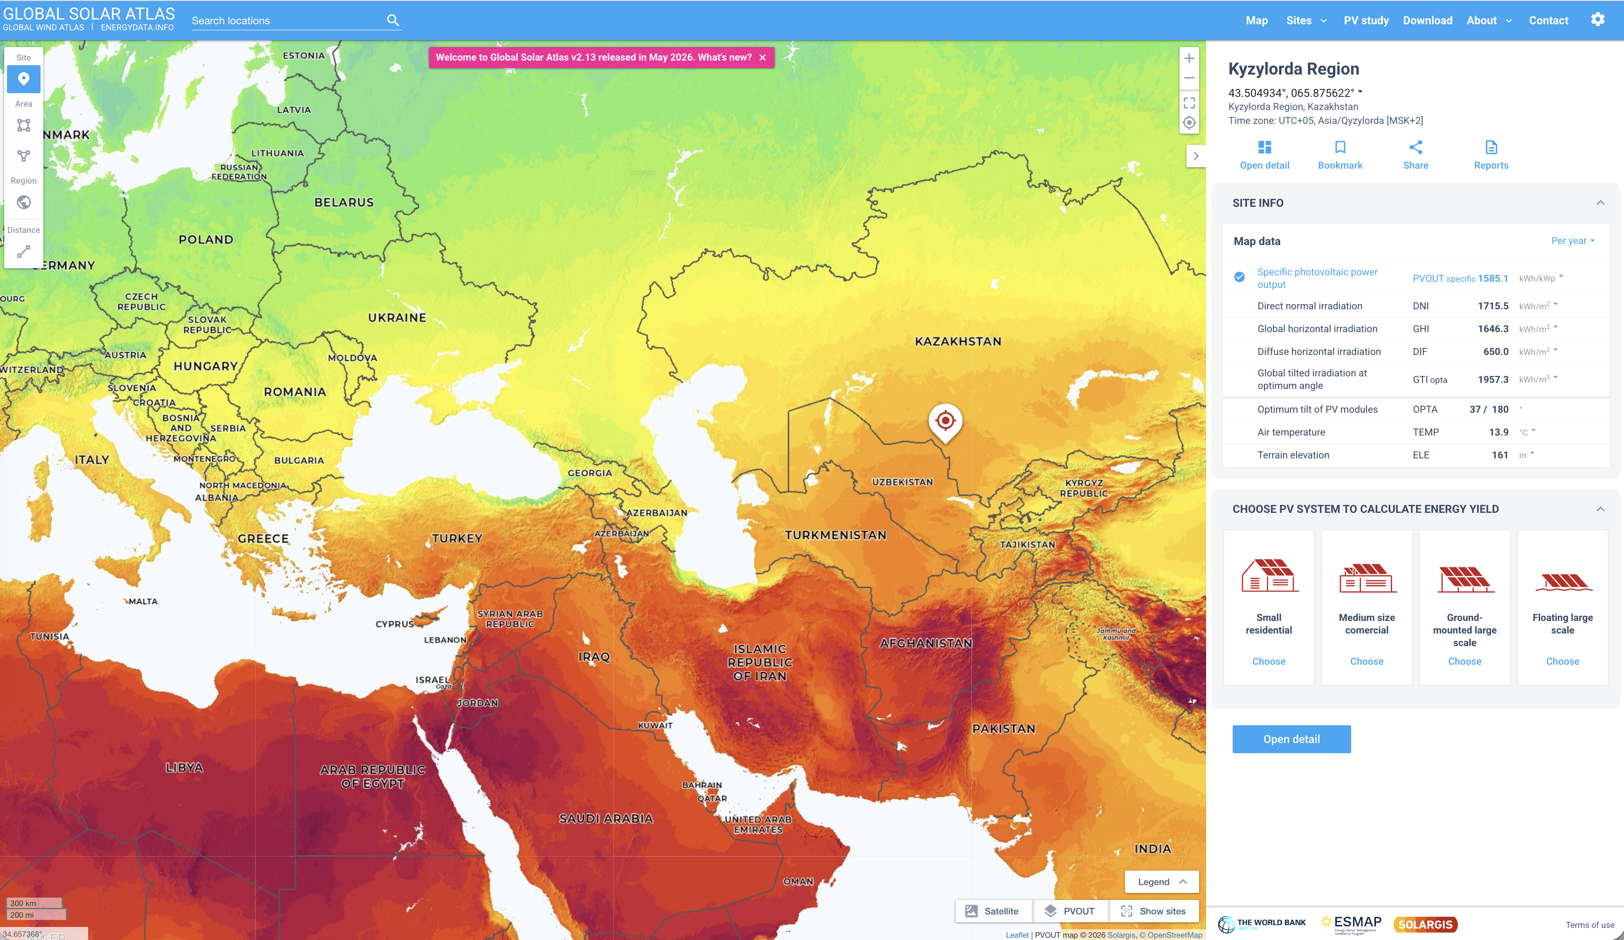
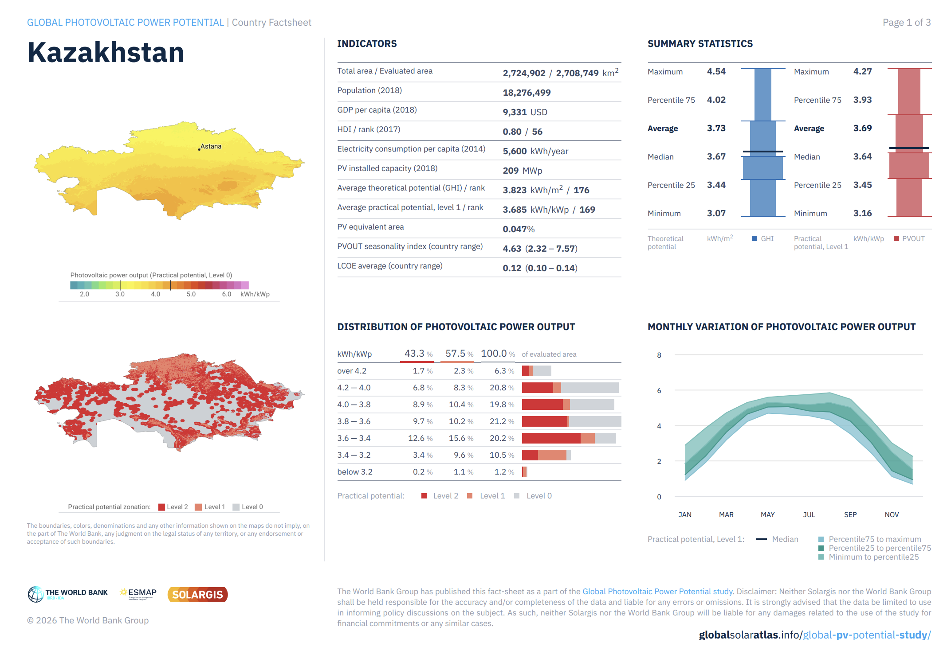
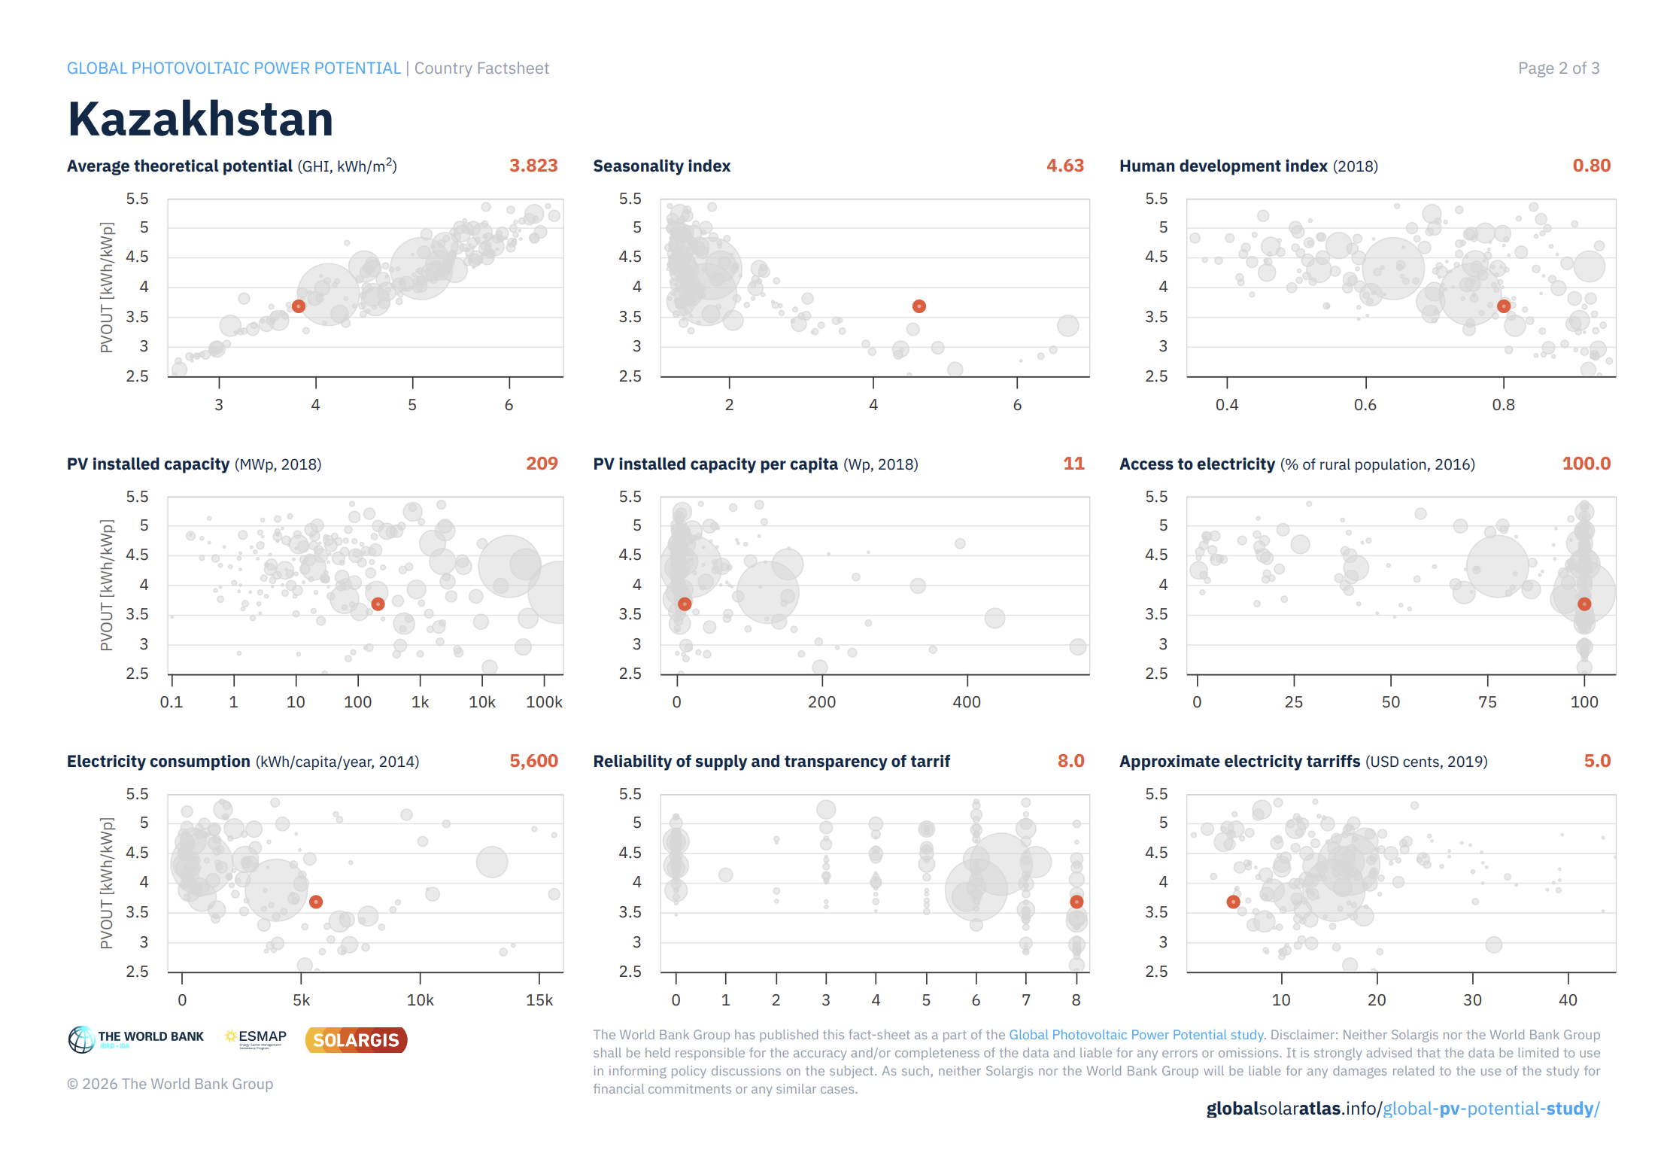
Global Solar Atlas
World is well-mapped through private and public initiatives
but with different level of uncertainty
Global Solar Atlas: open-access
to global solar potential data
https://globalsolaratlas.info/

Slide 16
Topic 2
Supporting large-scale
PV development sites

Slide 17

Preparing sites for large utility-scale projects
Land
Permits
Grid infrastructure
…
Procuring solar measurements for the project site
and more accurate solar model data
  Combining solar measurements with model
  reduces data uncertainty
https://solargis.com/resources/ebooks/best-practices-performance-evaluation-pv-plants

Slide 18
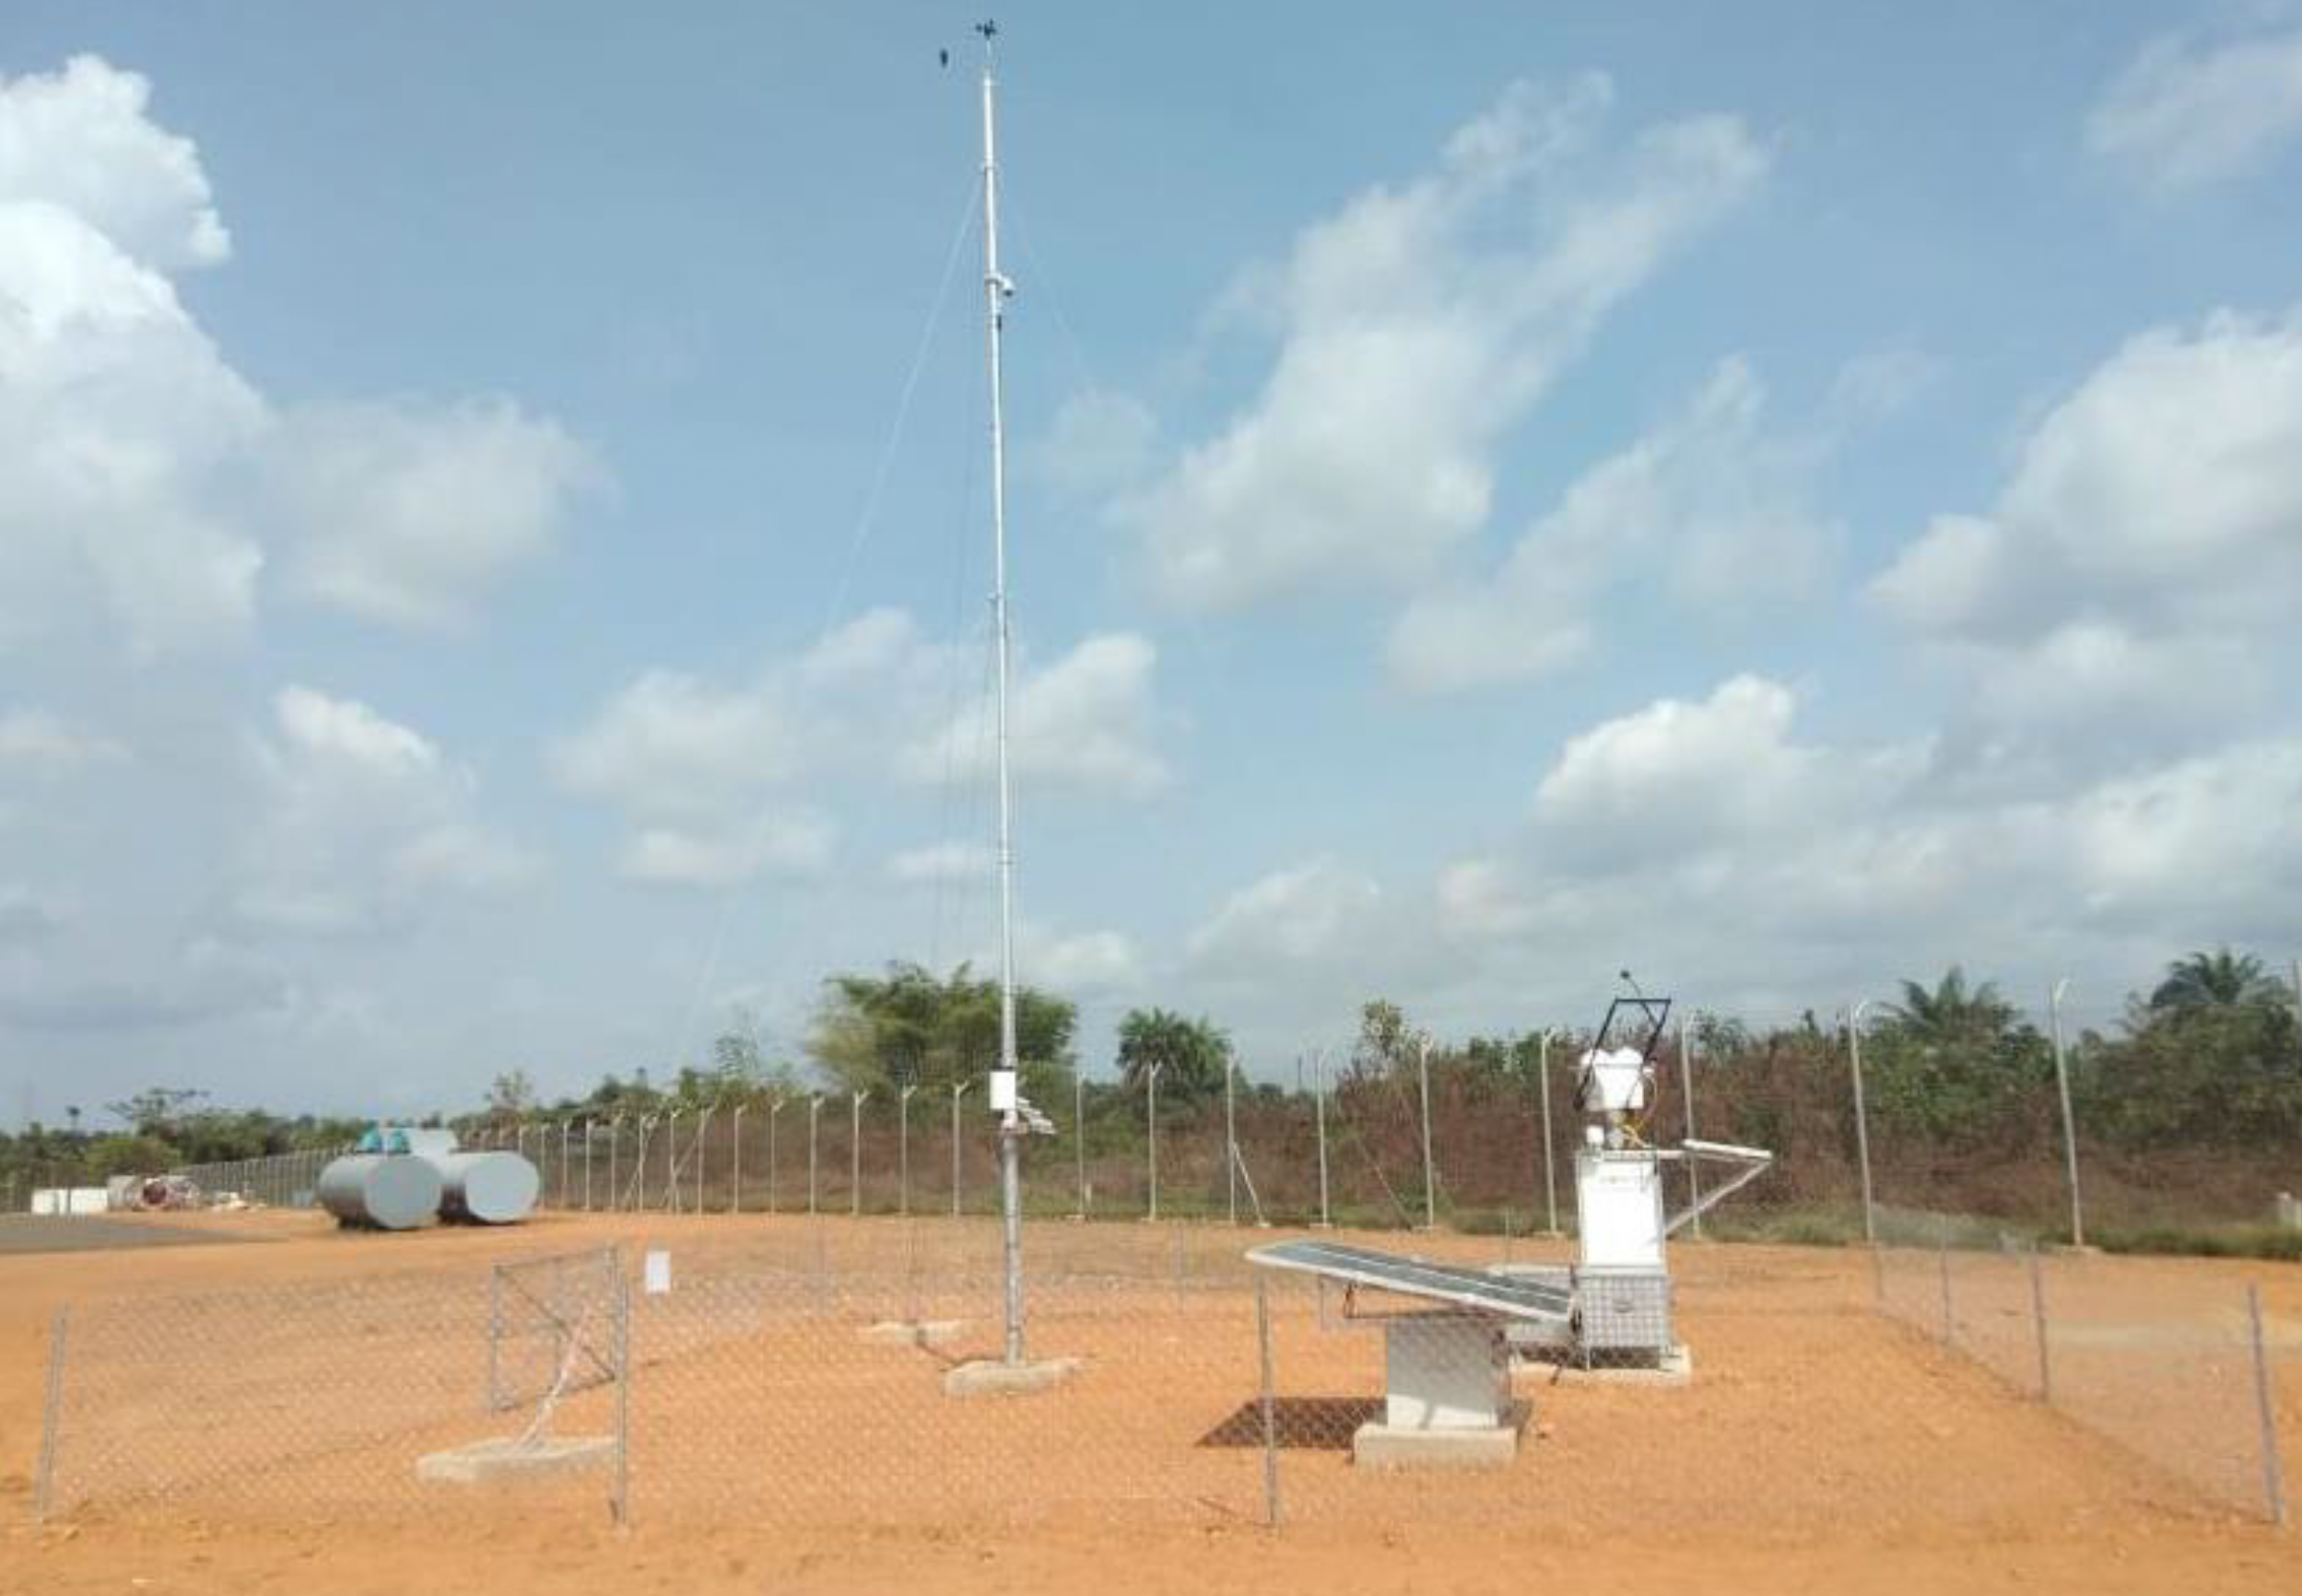
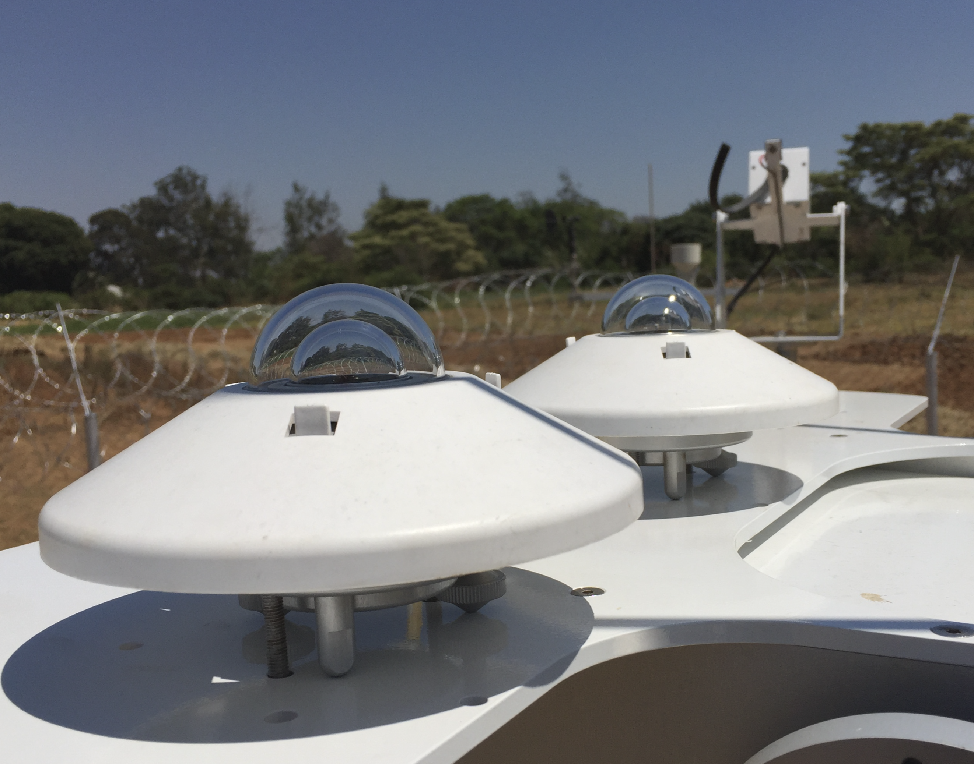
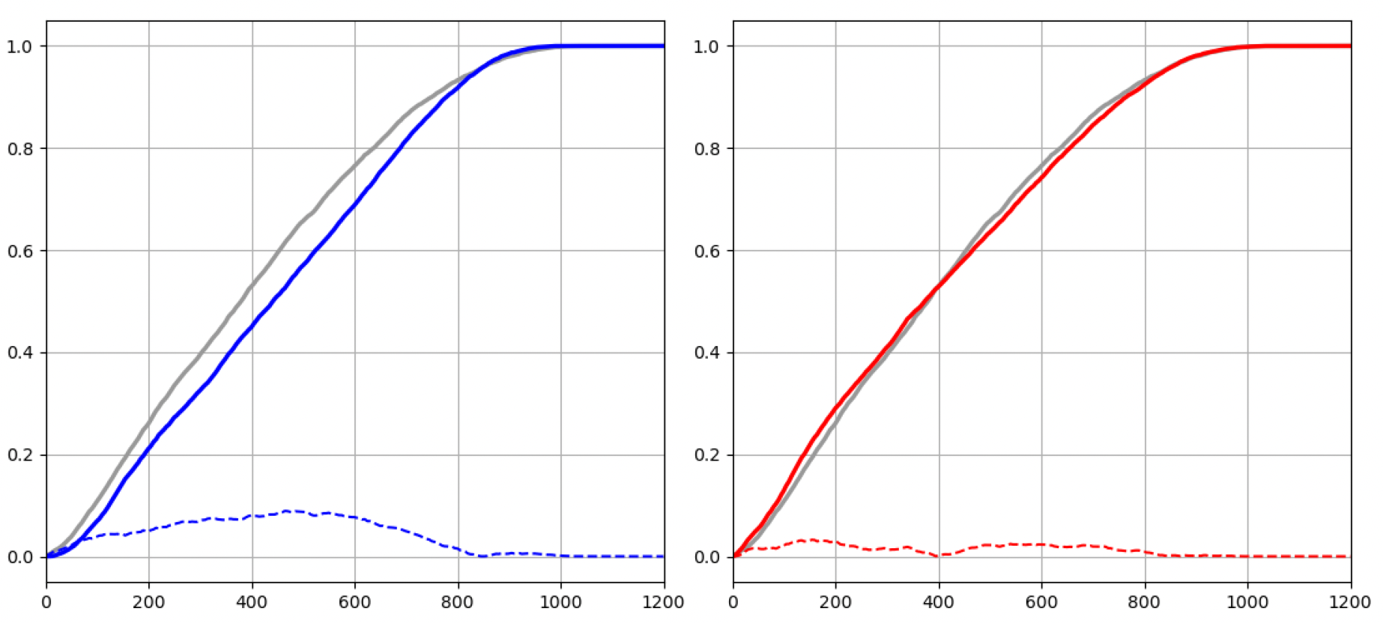
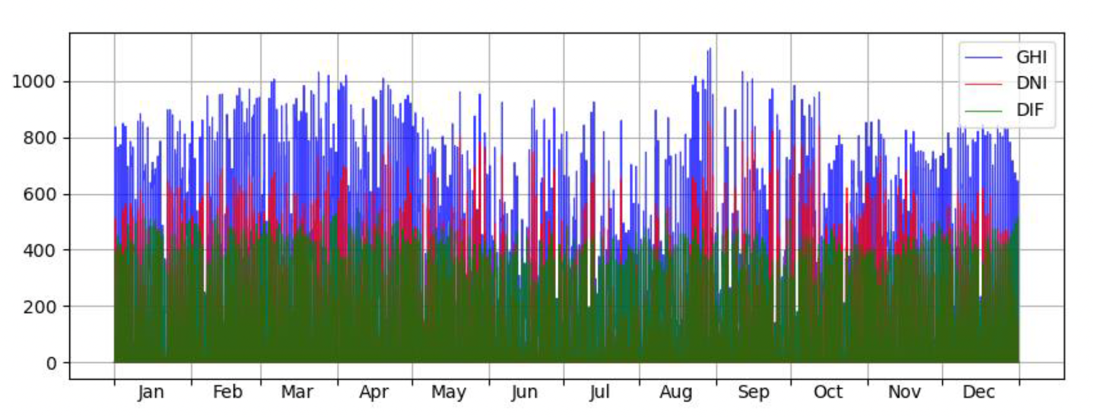
Acquiring high accuracy solar data
1. Local meteorological measurements
  Measurements for the site: minimum 12 months
  Technical setup and deliverables are standardized
2. Data from models
  History up to 30 years
  Adapting solar models by local measurements for higher accuracy
  Delivery: high-accuracy time series and Typical Meteorological Year data
  Accurate data are distributed to all bidders

Slide 19
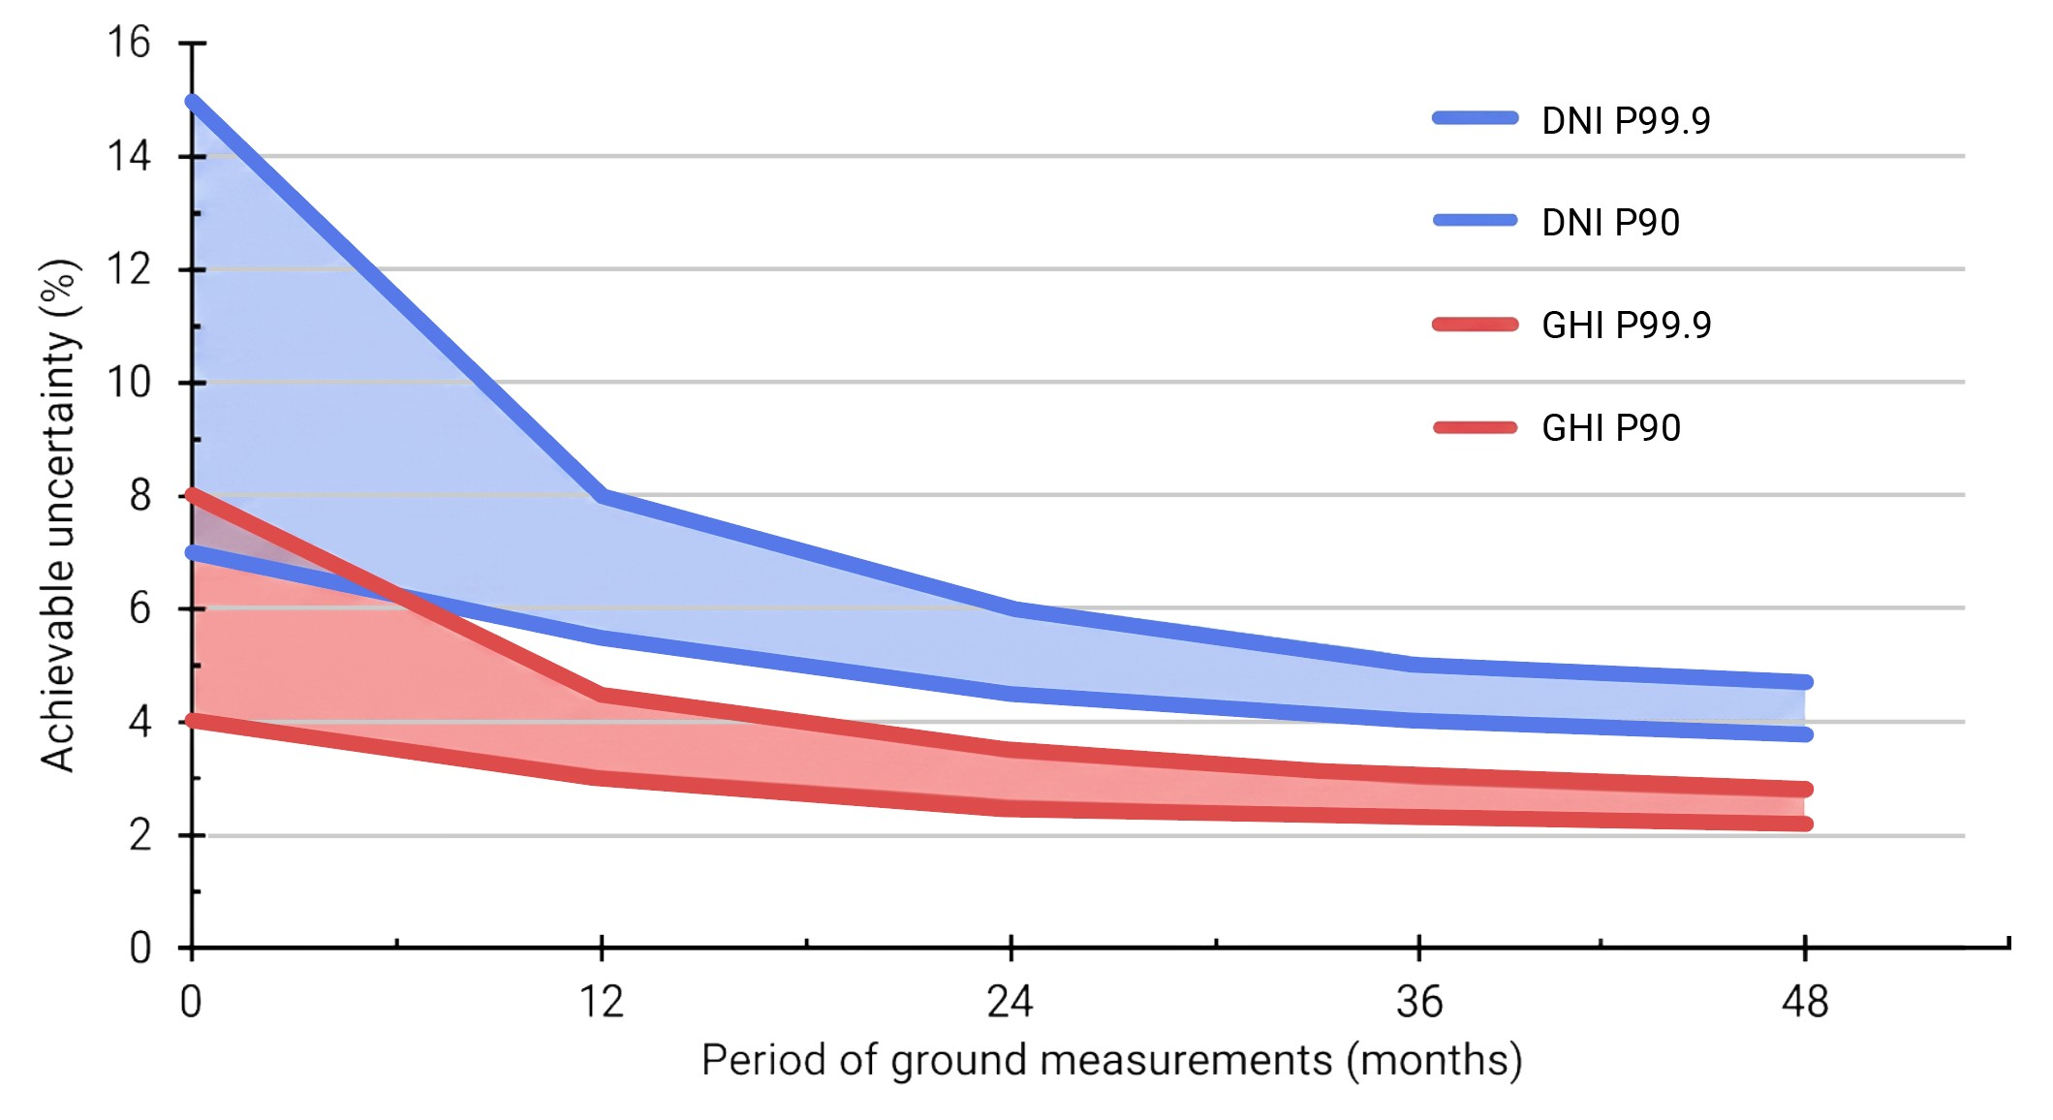
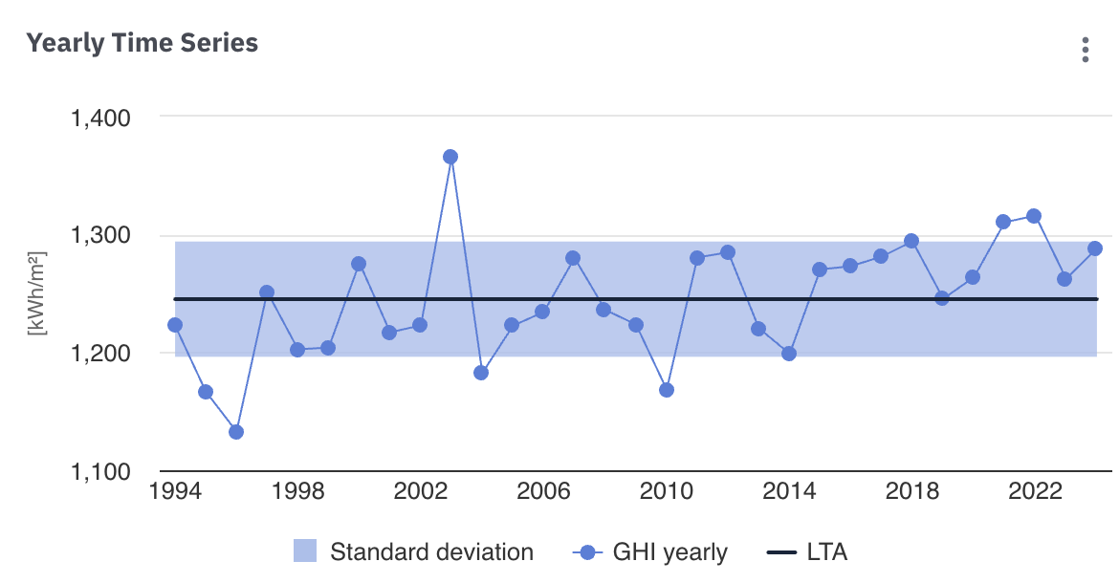
Uncertainty of solar resource
Objective of combining measurement with models
is to reduce data uncertainty
Sources of solar data uncertainty
Solar measurements and models
Solar resource variability
Climate change and long term trends
12 months of measurements reduces model uncertainty
GHI from 4-9 to 4-6%
DNI from 8-16 to 5-8%
The longer the measurements, the lower the uncertainty
of the solar model

Slide 20
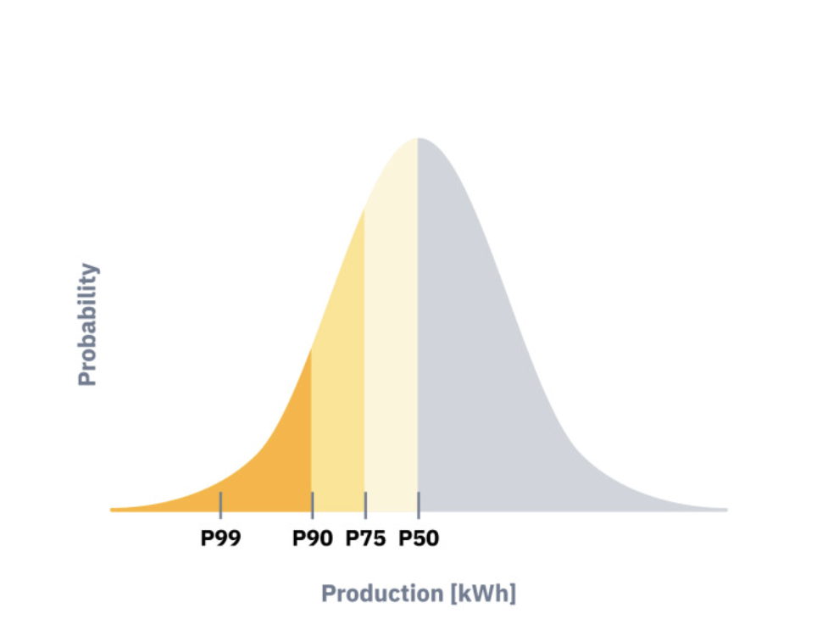
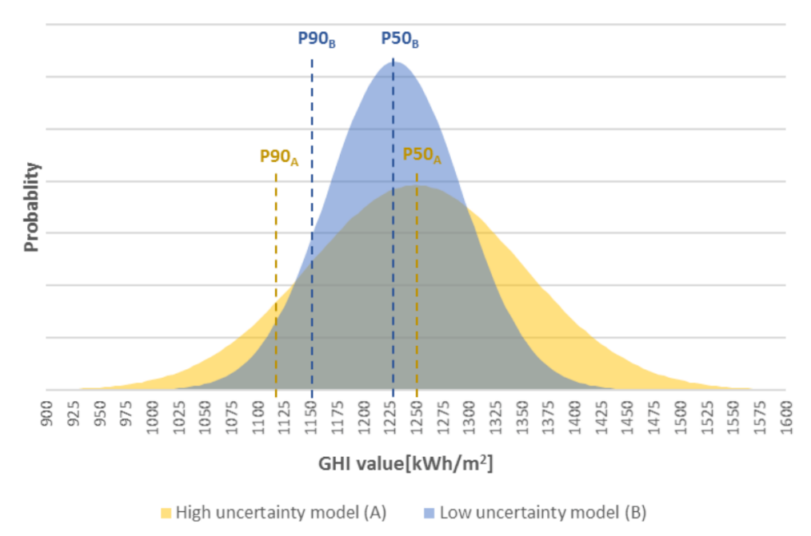
From uncertainty to probability of exceedance
Uncertainty = P50 - P90
P50: Average yield — best estimate, 50% probability of exceedance, baseline
P75: 75% probability of exceedance
P90: Key lender metric — yield exceeded 90% of time
Low uncertainty
High uncertainty
Notes:
Ground measurements are the reference for site adaptation. And a site adaptation is only going be as good as the reference. The uncertainty associated with the measured data has to be lower than the uncertainty of the satellite model data, to achieve any improvement.
In general, the rule is that the longer the ground measurements, the lower the achievable uncertainty after site adaptation. One full year is a minimum, but 2 to 3 years will likely improve the site adaption results.
Note here that well-installed and maintained instruments still have measurement uncertainty approaching 3%, so this is the physical limit of how good we can get. If somebody tells you their data have 1% uncertainty, you should be skeptical.
To get to this limit, the measurement campaign has to be well designed and executed. We have a handy reference for this – a new white paper published just last week, which you can find on our website in the resources section.

Slide 21
Benefits of reduced data uncertainty
Reducing uncertainty in solar data and energy yield calculations narrows the gap
between ‘expected’ and ‘bankable’
  More accurate P50
  Higher P90
Benefits of reduced uncertainty
  Engineers: Design optimized to local geography
  Banks: Higher loan, better DSCR, lower guarantees
  Investors: Defensible base case, realistic risk assumptions, capital structure more efficient
Risks are lower and better understood
Higher confidence in calculation

Slide 22
Topic 3
Management of large fleets of solar

Slide 23
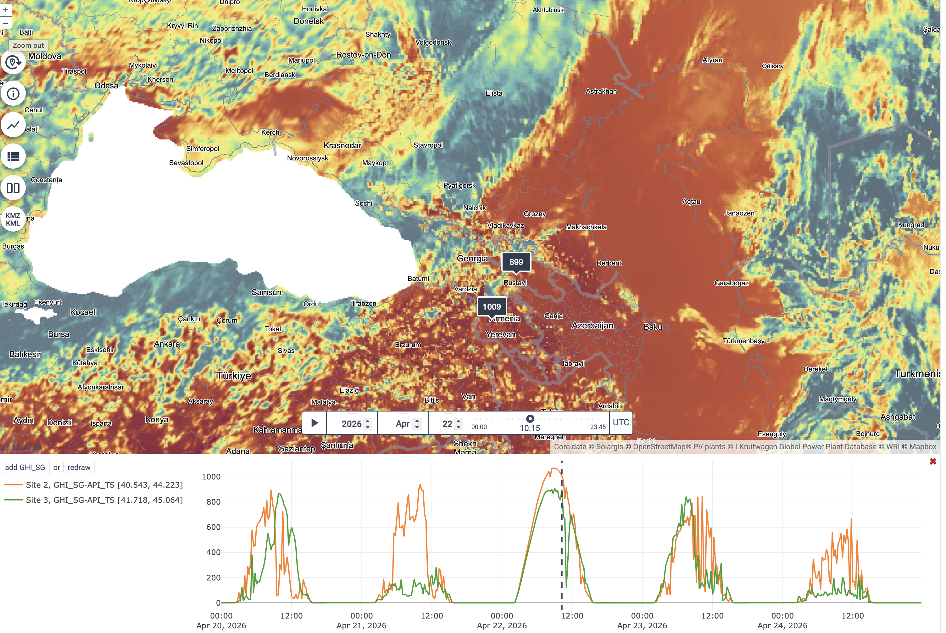
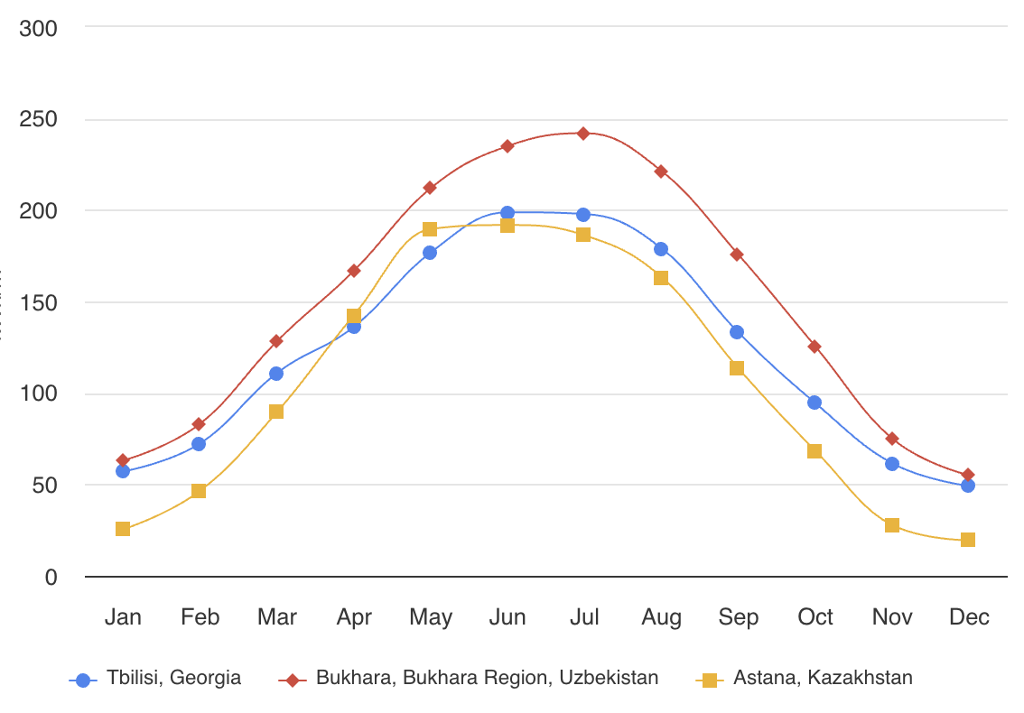
Solar variability and how to manage it
Solar resource variability
  Seasonal variability
  Day-by-day variability
  Short term variability and high frequency changes
Historical data provide insights for design of PV systems,
financing, managing the risks
Solar power operation needs forecast for next minutes, hours, days
  Technical management and trading
  Managing single system or entire portfolio

Slide 24
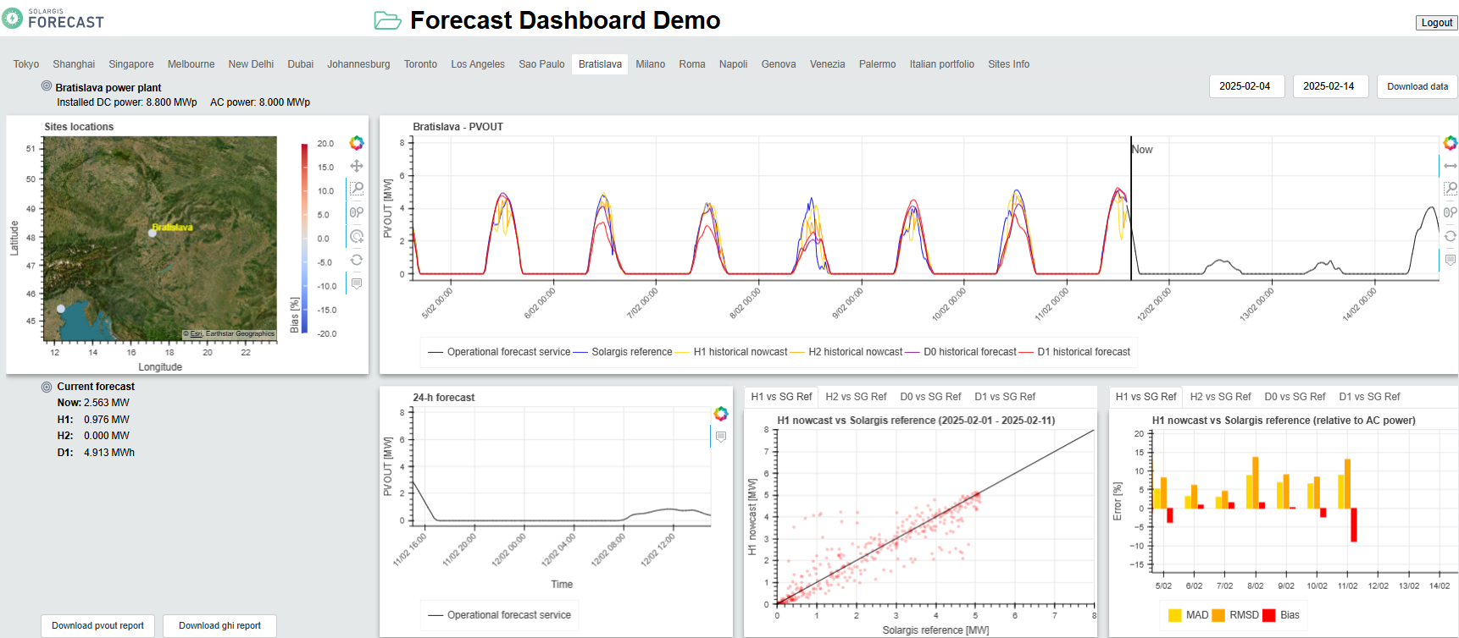
Solar variability and how to manage it
Solar resource variability
  Seasonal variability
  Day-by-day variability
  Short term variability and high frequency changes
Historical data provide insights for design of PV systems,
financing, managing the risks
Solar power operation needs forecast for next minutes, hours days
  Technical management and trading
  Managing single system or entire portfolio

Slide 25
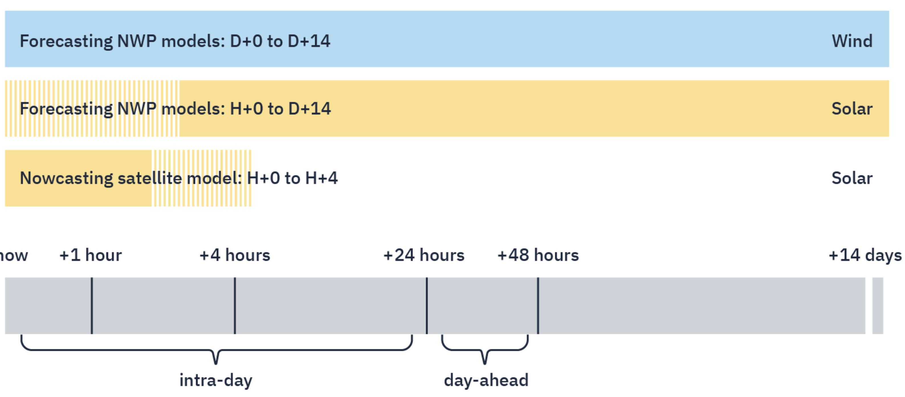
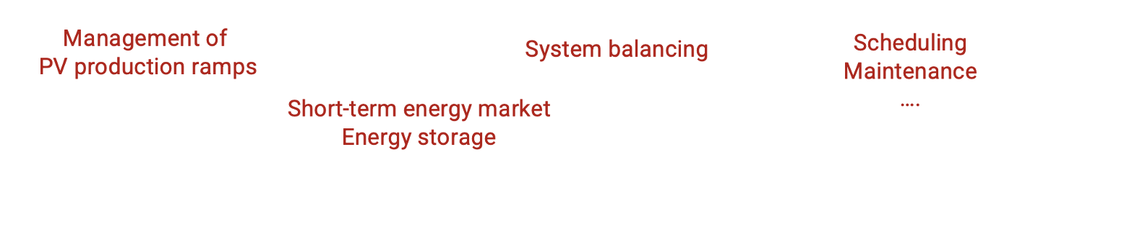
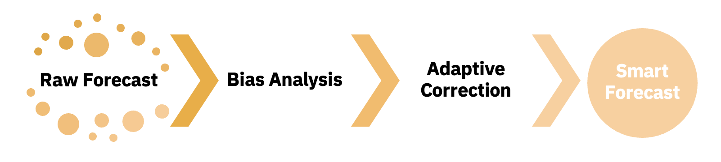
Solar forecasting approaches
Standard (raw) forecast
  Global numerical weather prediction (NWP) models
  up to 14 days
  Nowcasting satellite model
  up to 4 hours
Smart forecast = accuracy enhanced by:
  Data monitored at power plants
  Price forecast (demand/supply)
  Grid operation forecast (curtailment)

Slide 26
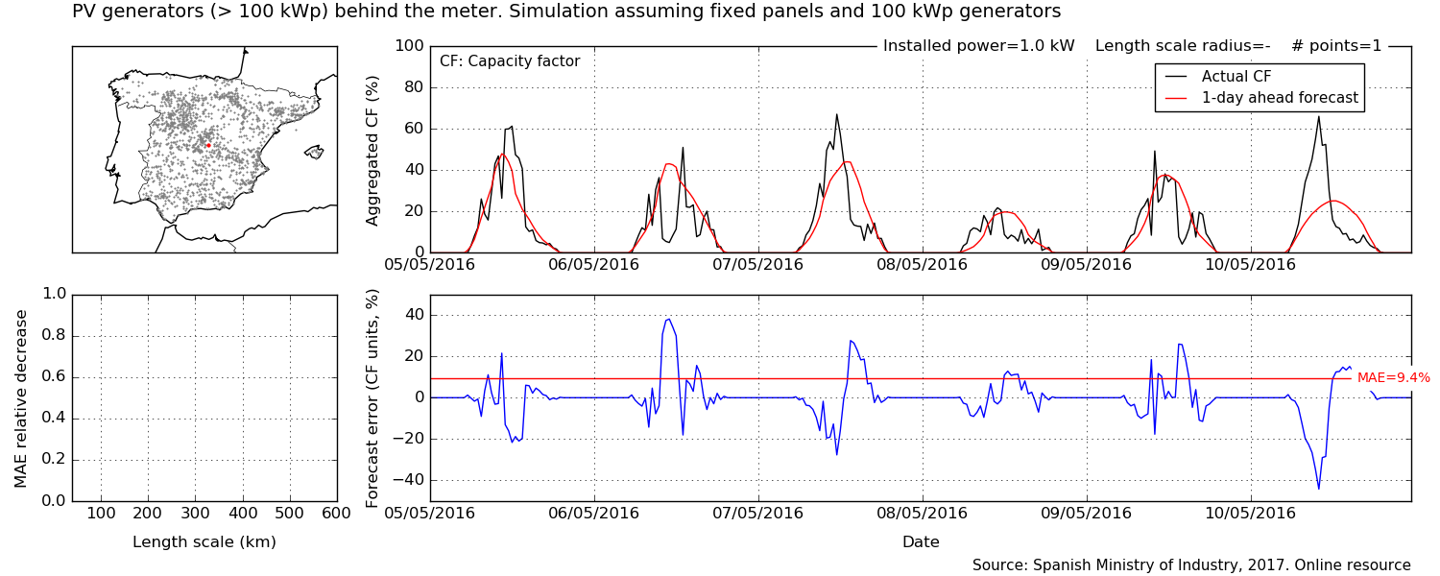
Forecasting accuracy for 1 site vs portfolio (Spain)
1 location

Slide 27
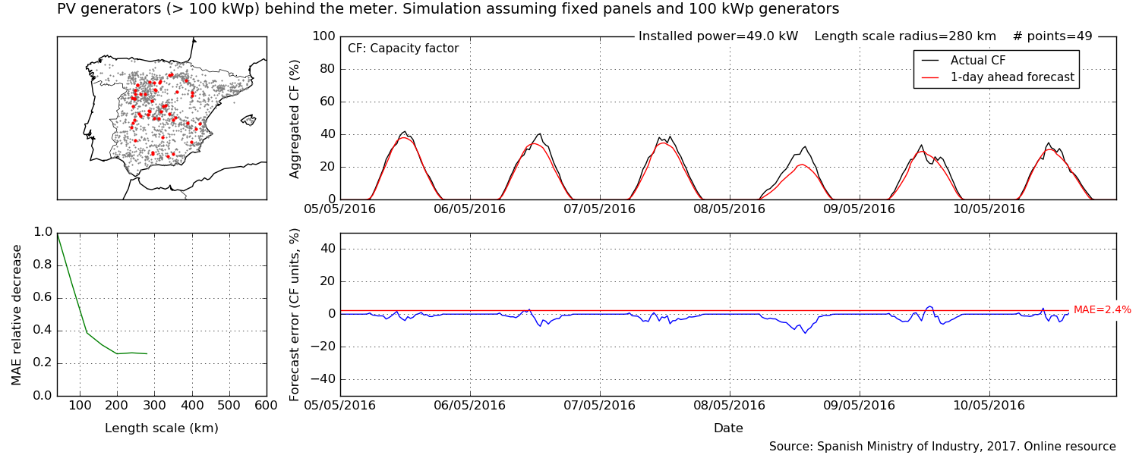
Forecasting accuracy for 1 site vs portfolio (Spain)
49 locations

Slide 28
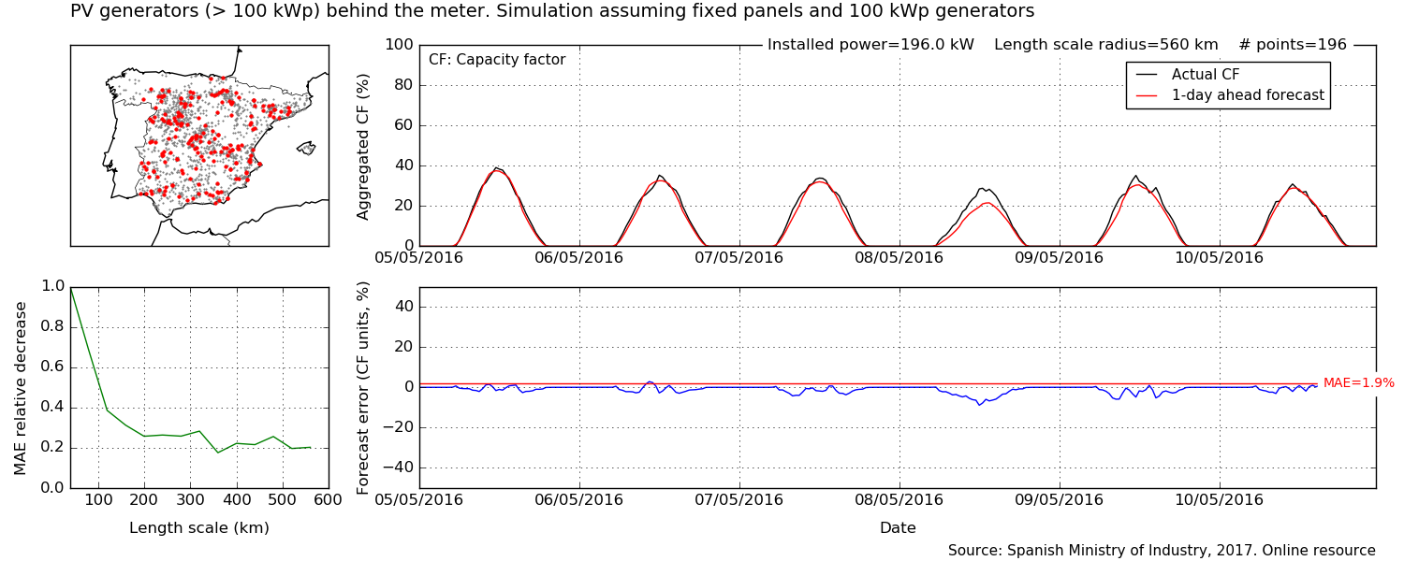
Forecasting accuracy for 1 site vs portfolio (Spain)
196 locations

Slide 29
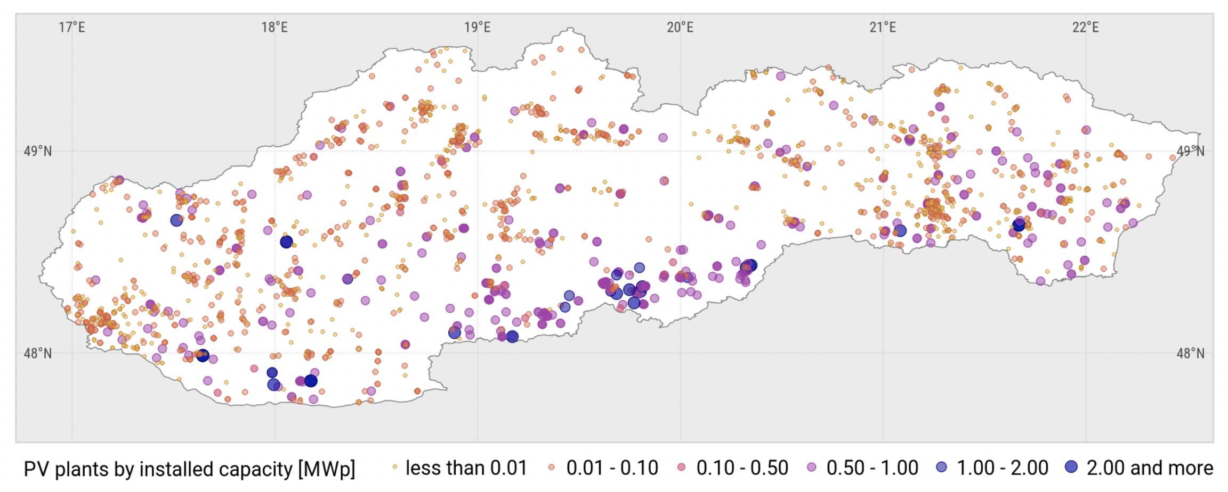
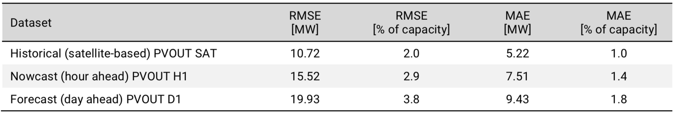
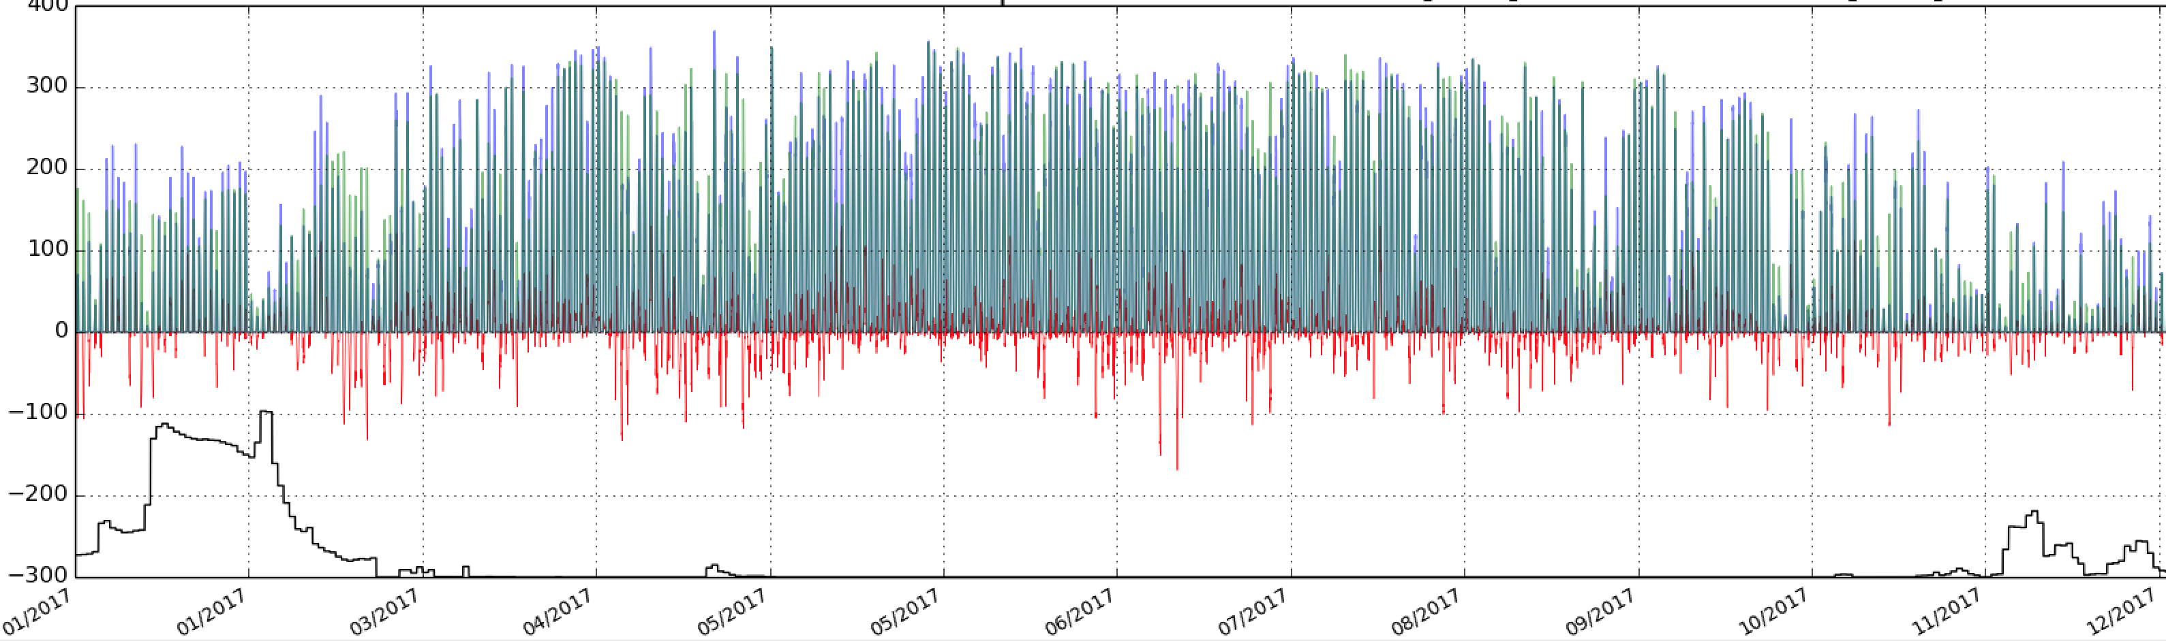
Solar forecast accuracy (Slovakia)
Satellite-based PVOUT (reference)
PV power forecast - hour ahead (H1)
PV power forecast - day ahead (D1)
Total considered PV capacity: 530 MW
Day ahead PV power forecast (D1)
Forecast error
Occurrence of snow
Jan Apr Jul Oct Dec

Slide 30
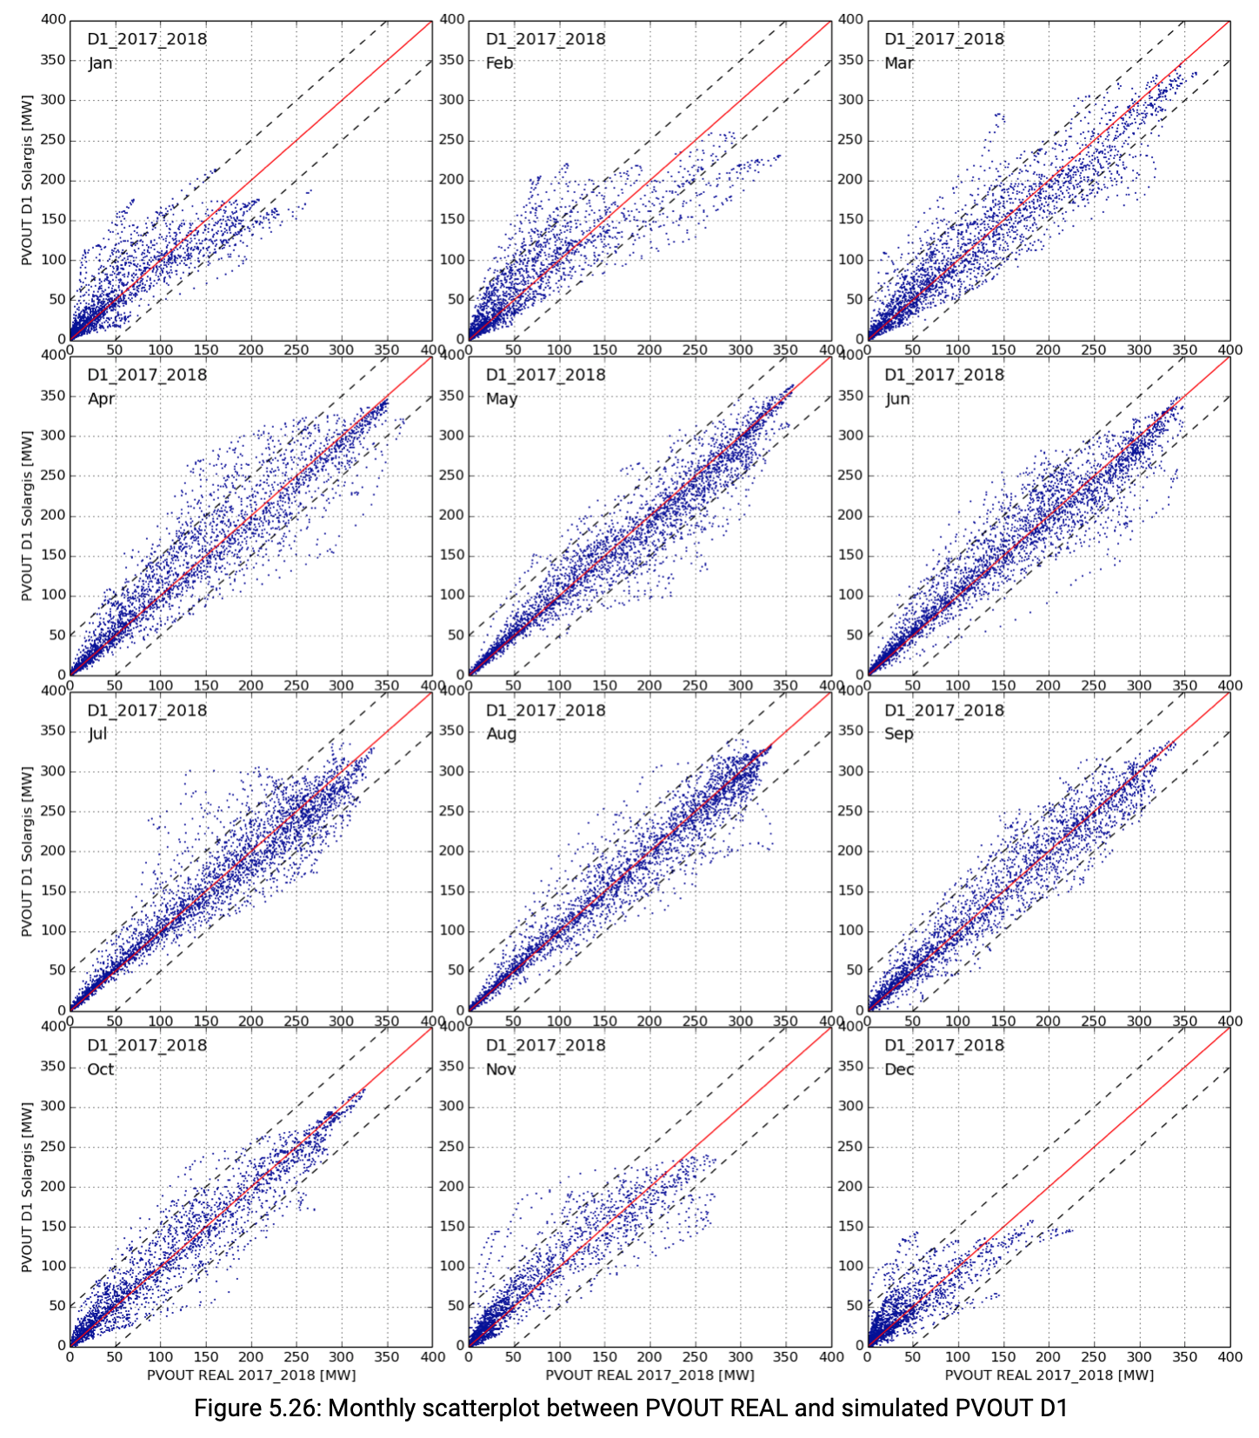
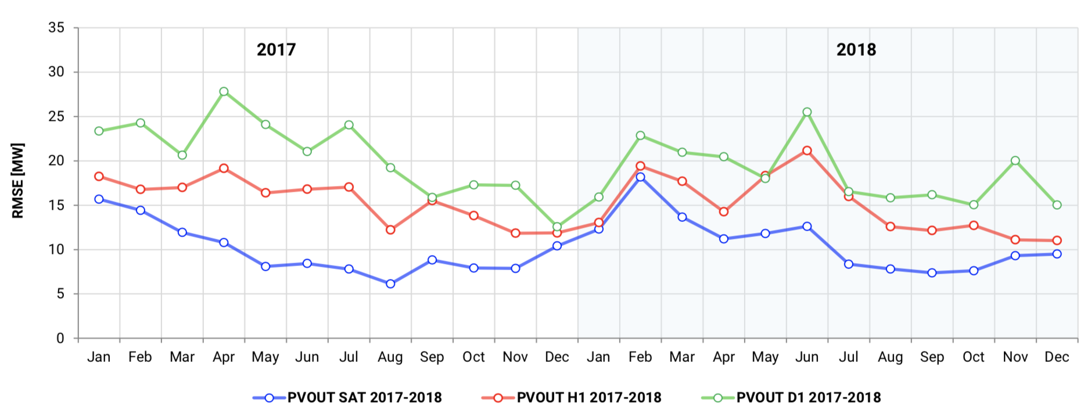
Solar forecast accuracy (Slovakia)
Satellite-based PVOUT (reference)
PV power forecast - hour ahead (H1)
PV power forecast - day ahead (D1)
Total considered PV capacity: 530 MW
Reference Hour ahead forecast (H1) Day ahead forecast (D1)
Day ahead
forecast (D1)

Slide 31
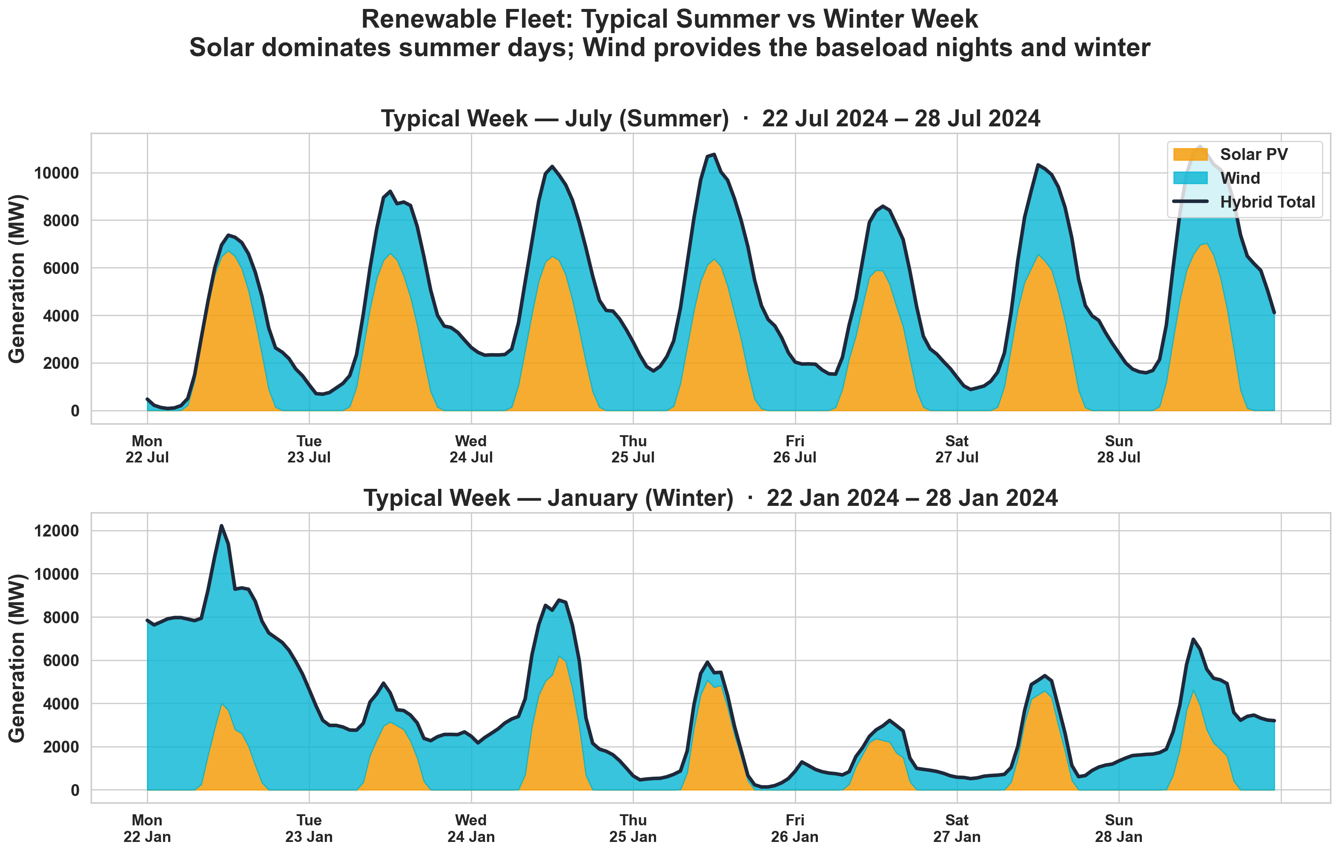
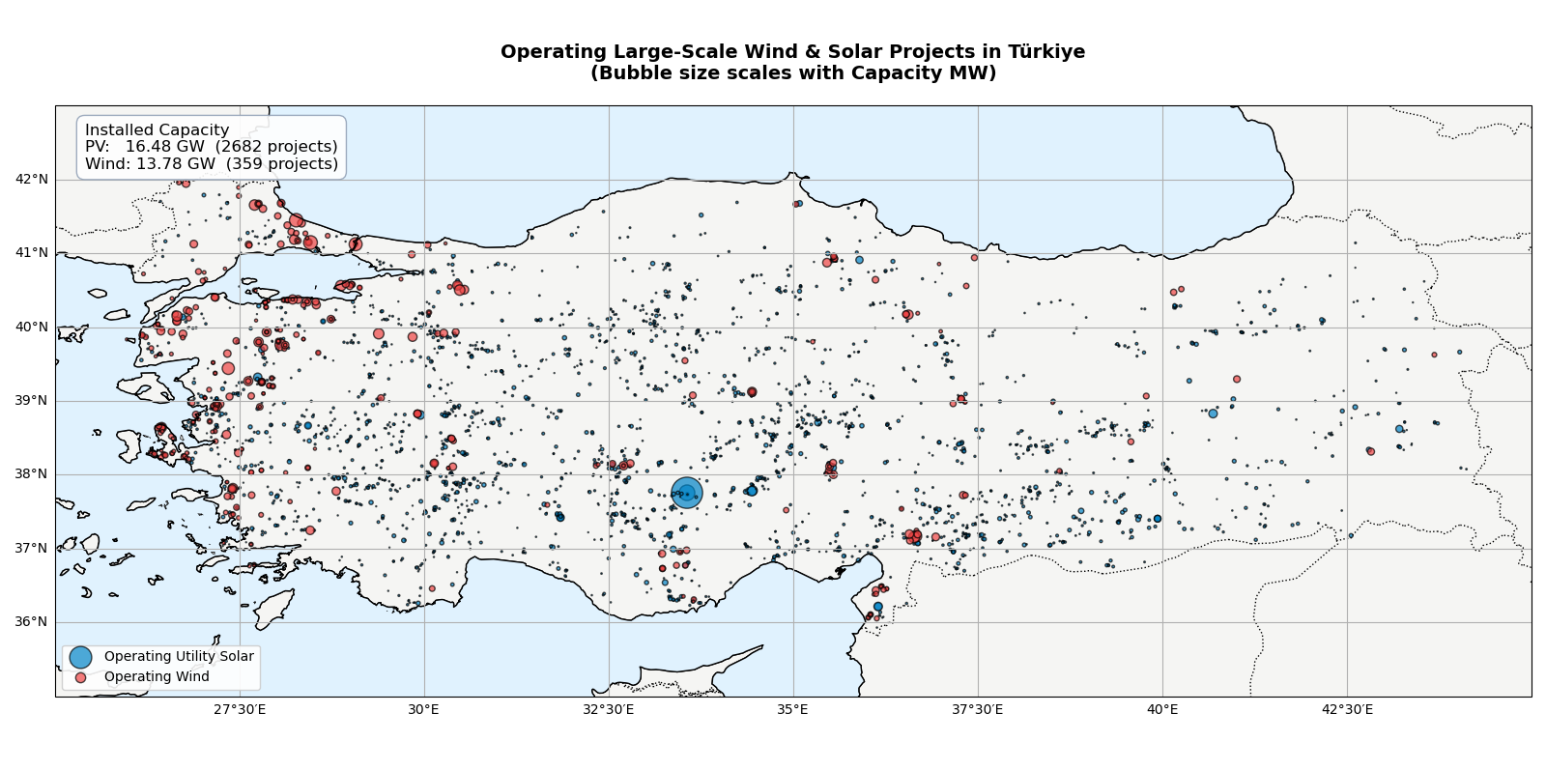
Complementarity of solar and wind power (Türkiye)
682 utility-scale PV projects: 16.48 GW
359 wind parks: 13.78 GW
Source: IFS forecast, https://globalenergymonitor.org/
Typical solar and wind generation profiles:
July
January

Slide 32
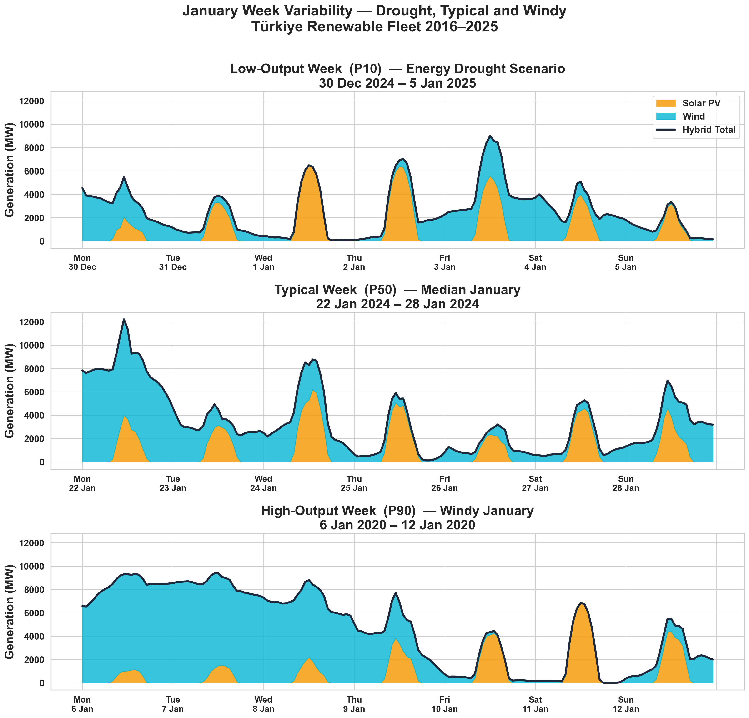
Complementarity of solar and wind power (Türkiye)
682 utility-scale PV projects: 16.48 GW
359 wind parks: 13.78 GW
Source: IFS forecast, https://globalenergymonitor.org/
Solar and wind generation profiles in January
Low
Median
High

Slide 33
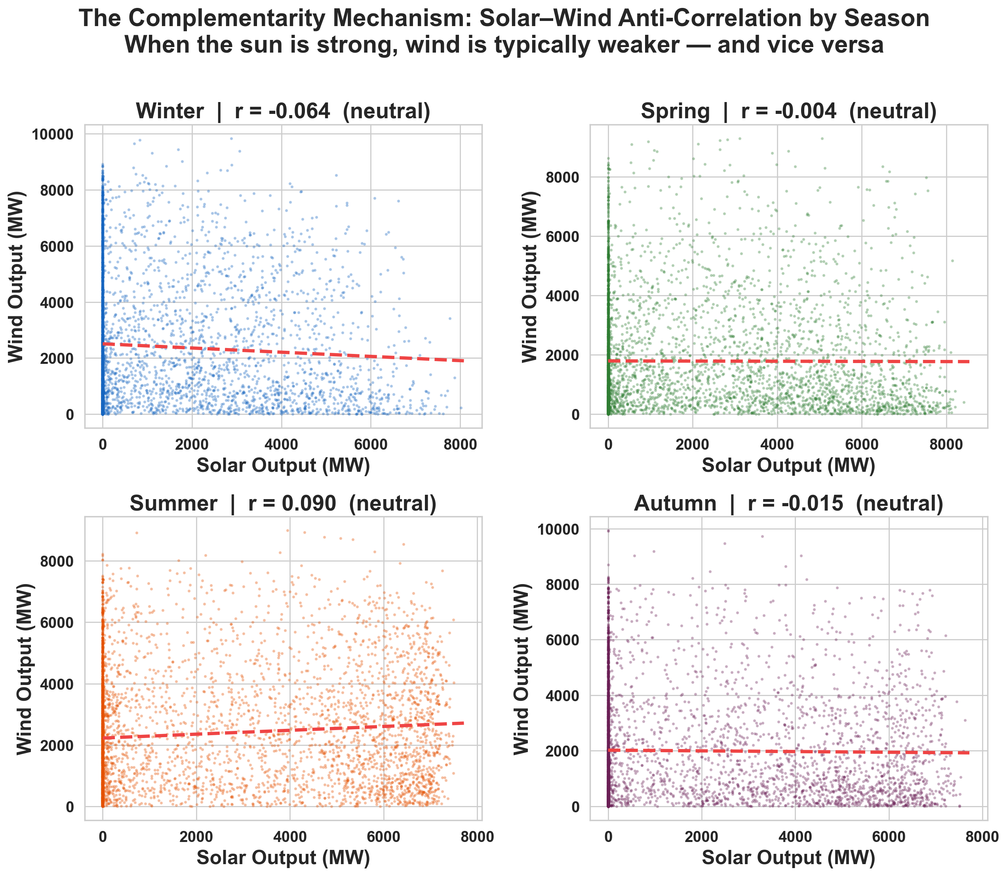
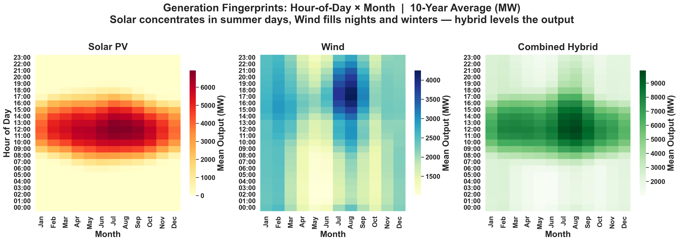
Complementarity of solar and wind power (Türkiye)
Wind and solar are not correlated
Typical power generation profiles for solar, wind and combined

Slide 34
Conclusions
Models are the only reliable data source
Data from models to be combined with on-site measurements
Once projects are online, forecast is to manage variability
  Country-wide inventory, understanding resource potential and variability
  Supporting strategical projects with site-specific measurements
    First measurements from public funding
    Later, private industry takes over
  Solar power forecasting to balance demand and supply
    Complementary profiles of solar and wind
Solar resource data and digital tools help to build and manage solar energy programs
at the level of individual projects and entire countries

Slide 35

Thank you
Solar Resource Data and Digital Tools for Renewable Energy Scale-Up
Marcel Suri
CEO, Solargis
solargis.com

Slide 36
https://www.iea.org/countries/indonesia/electricity
Solar PV mapping and development plan (Indonesia)
Analysis of potential locations for development of 1 GW solar infrastructure in Java, Madura & Bali
Client: Southeast Asia Energy Transition Partnership (ETP) / UNOPS
Partner: Ministry of National Development Planning of Indonesia (BAPPENAS)
Implementing partner: Trama TecnoAmbiental (TTA)
Solargis provided the solar resource modelling and geospatial analysis for the project
Objectives
Site identification — technically viable areas for utility-scale PV
Environmental & social assessment — risks to ensure sustainable and responsible development
Grid impact evaluation — grid integration requirements and the hosting capacity
Site prioritization — ranked list of sites for planning utility-scale PV projects
https://www.energytransitionpartnership.org/projects/1-gw-solar-mapping-and-development-plan/

Slide 37
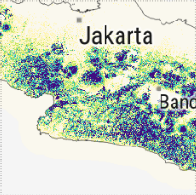
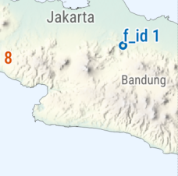
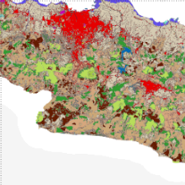
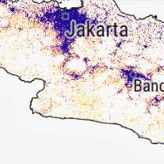
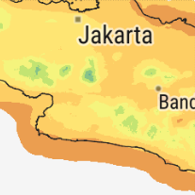


Solar PV mapping and development plan (Indonesia)
Multi-criteria geospatial analysis for selection of utility-scale PV sites
General understanding of solar resource
Grid connection, proximity to demand centres
Management of variability in PV power generation
Risk assessment
Areas where solar investment delivers the best value
Planning of future grid development

